Slide 1
Bydgoszcz in the Eyes of Sebastian Serlio
Made by Pierre Langrand G8

Slide 2
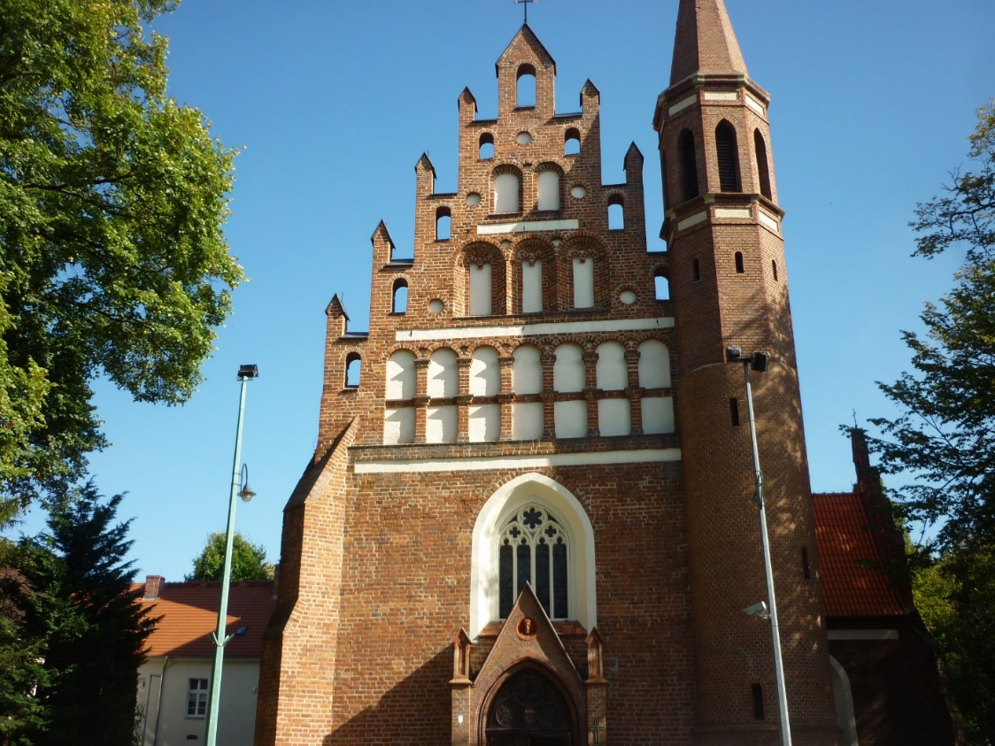
The Comic Scene
I chose this building because in the Comic Scene, there is always a church.
Garison’s church
Taken on the 28/09/2014

Slide 3
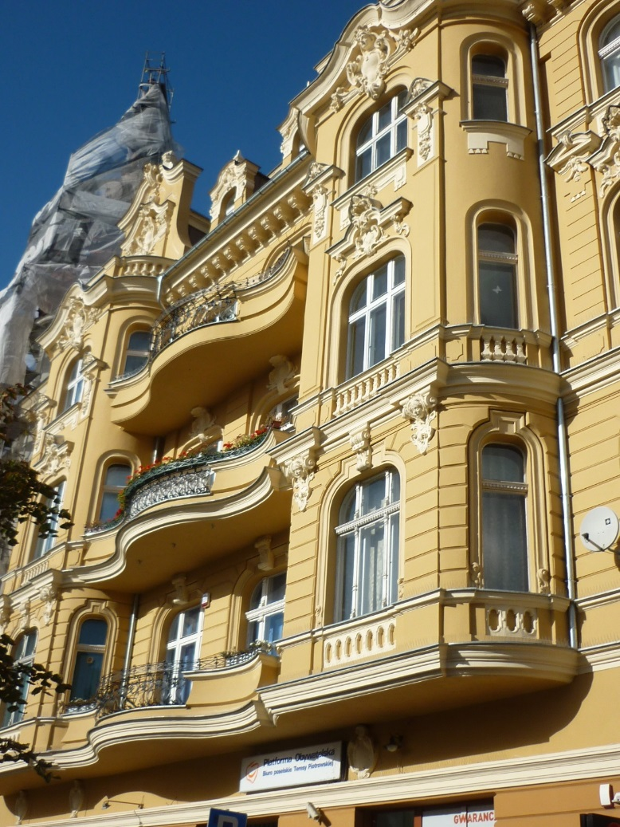
The Tragic Scene
I chose this building because in the Tragic Scene, buildings are the ones of rich persons.
A biulding near Plac Wolnosci
Taken on the 27/09/2014

Slide 4
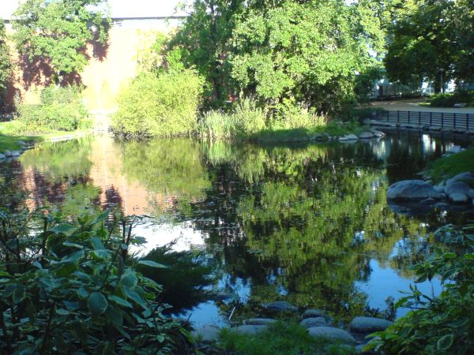
The Satiricall Scene
I chose this place because in the Satiricall Scene, the scene is usually with trees and gardens.
Parc Kasimir the Great
Taken on tne 27/09/2014

Slide 5
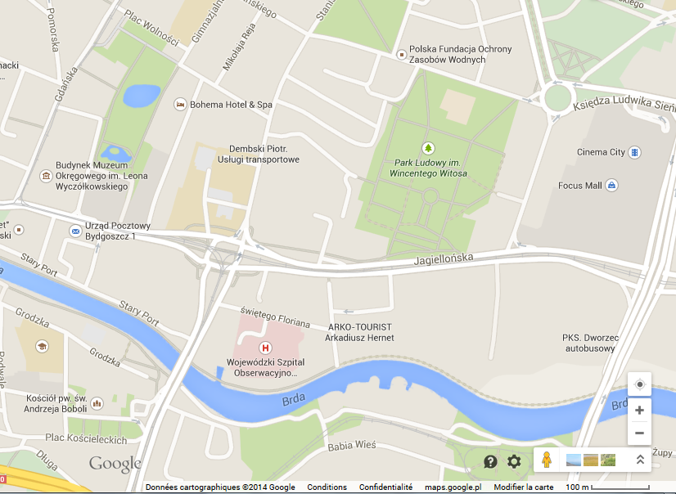
Locations of my photos
The Tragic Scene
The Satiricall Scene
The Comic Scene

