Slide 1
Serlio’s Three Scenes in Bydgoszcz
By: Nikolas Ament

Slide 2
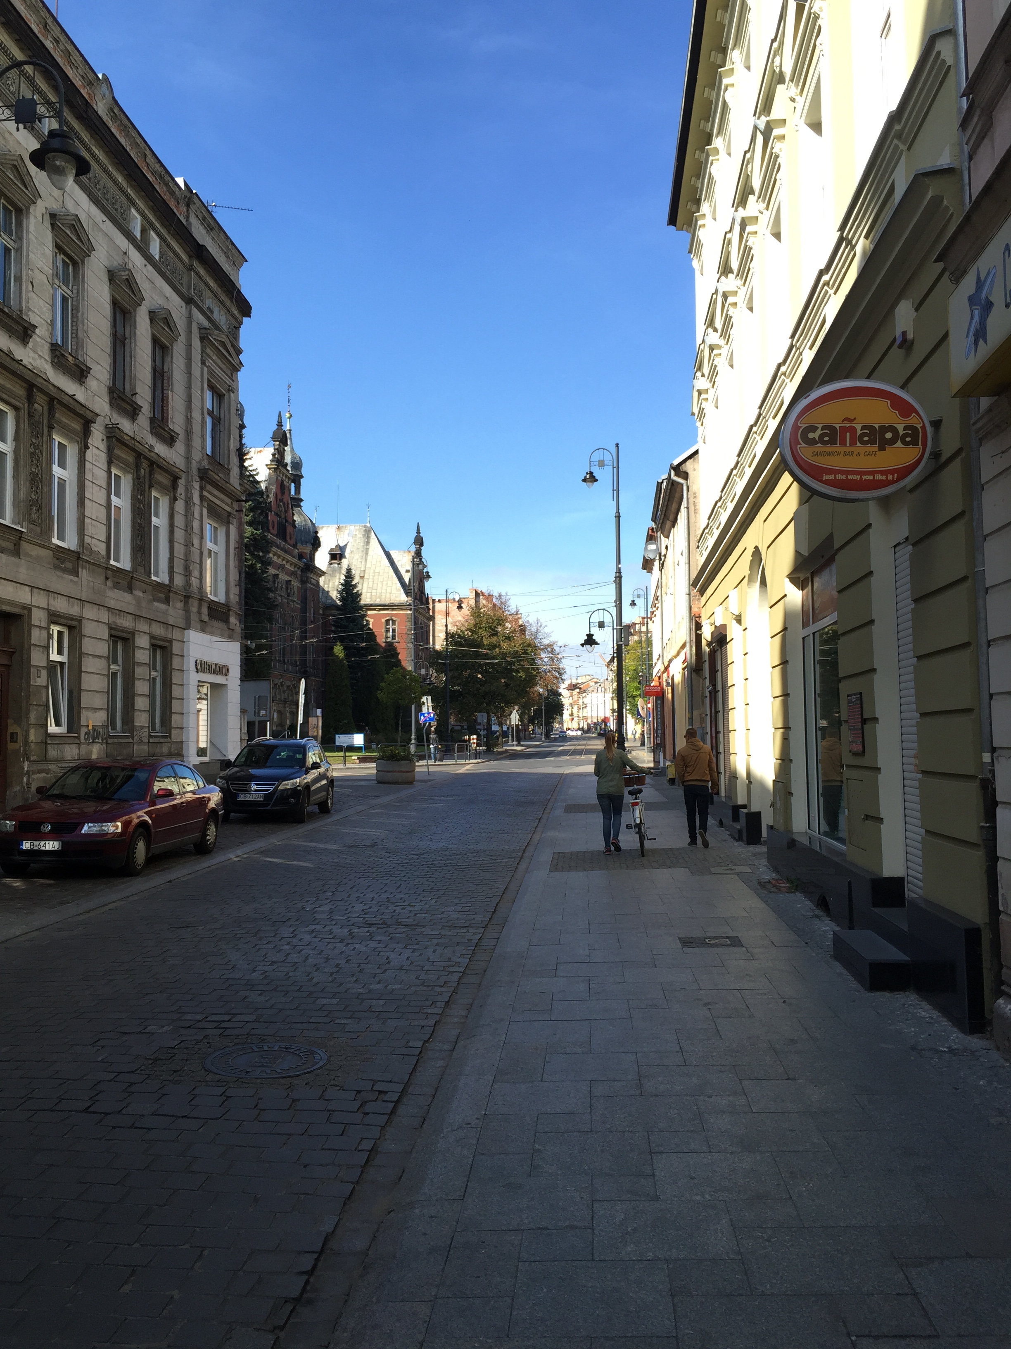
The Comic scene:
Sunday, 28th of September Dworcowa 61
This picture is a demonstration of a comic scene because as described by Serlio, it is “a world of it’s own”. It has shops, a church, places to live, and it also has no specific order to it, making it the perfect comic scene.

Slide 3
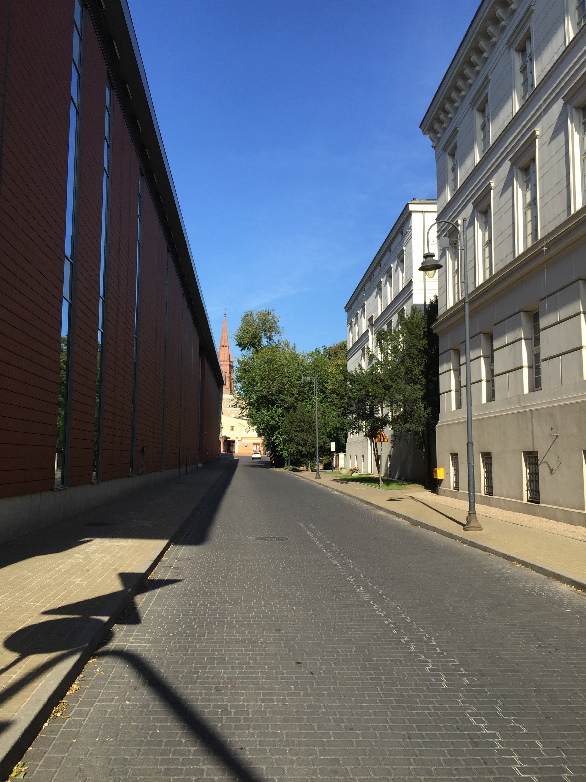
The Tragic Scene
Sunday, September 28th:
19 Marca 1981 Roku
This picture describes the tragic scene because it shows a straight row of official like buildings leading down to a tall tower, making it nothing comic or satiric, but plain tragic

Slide 4
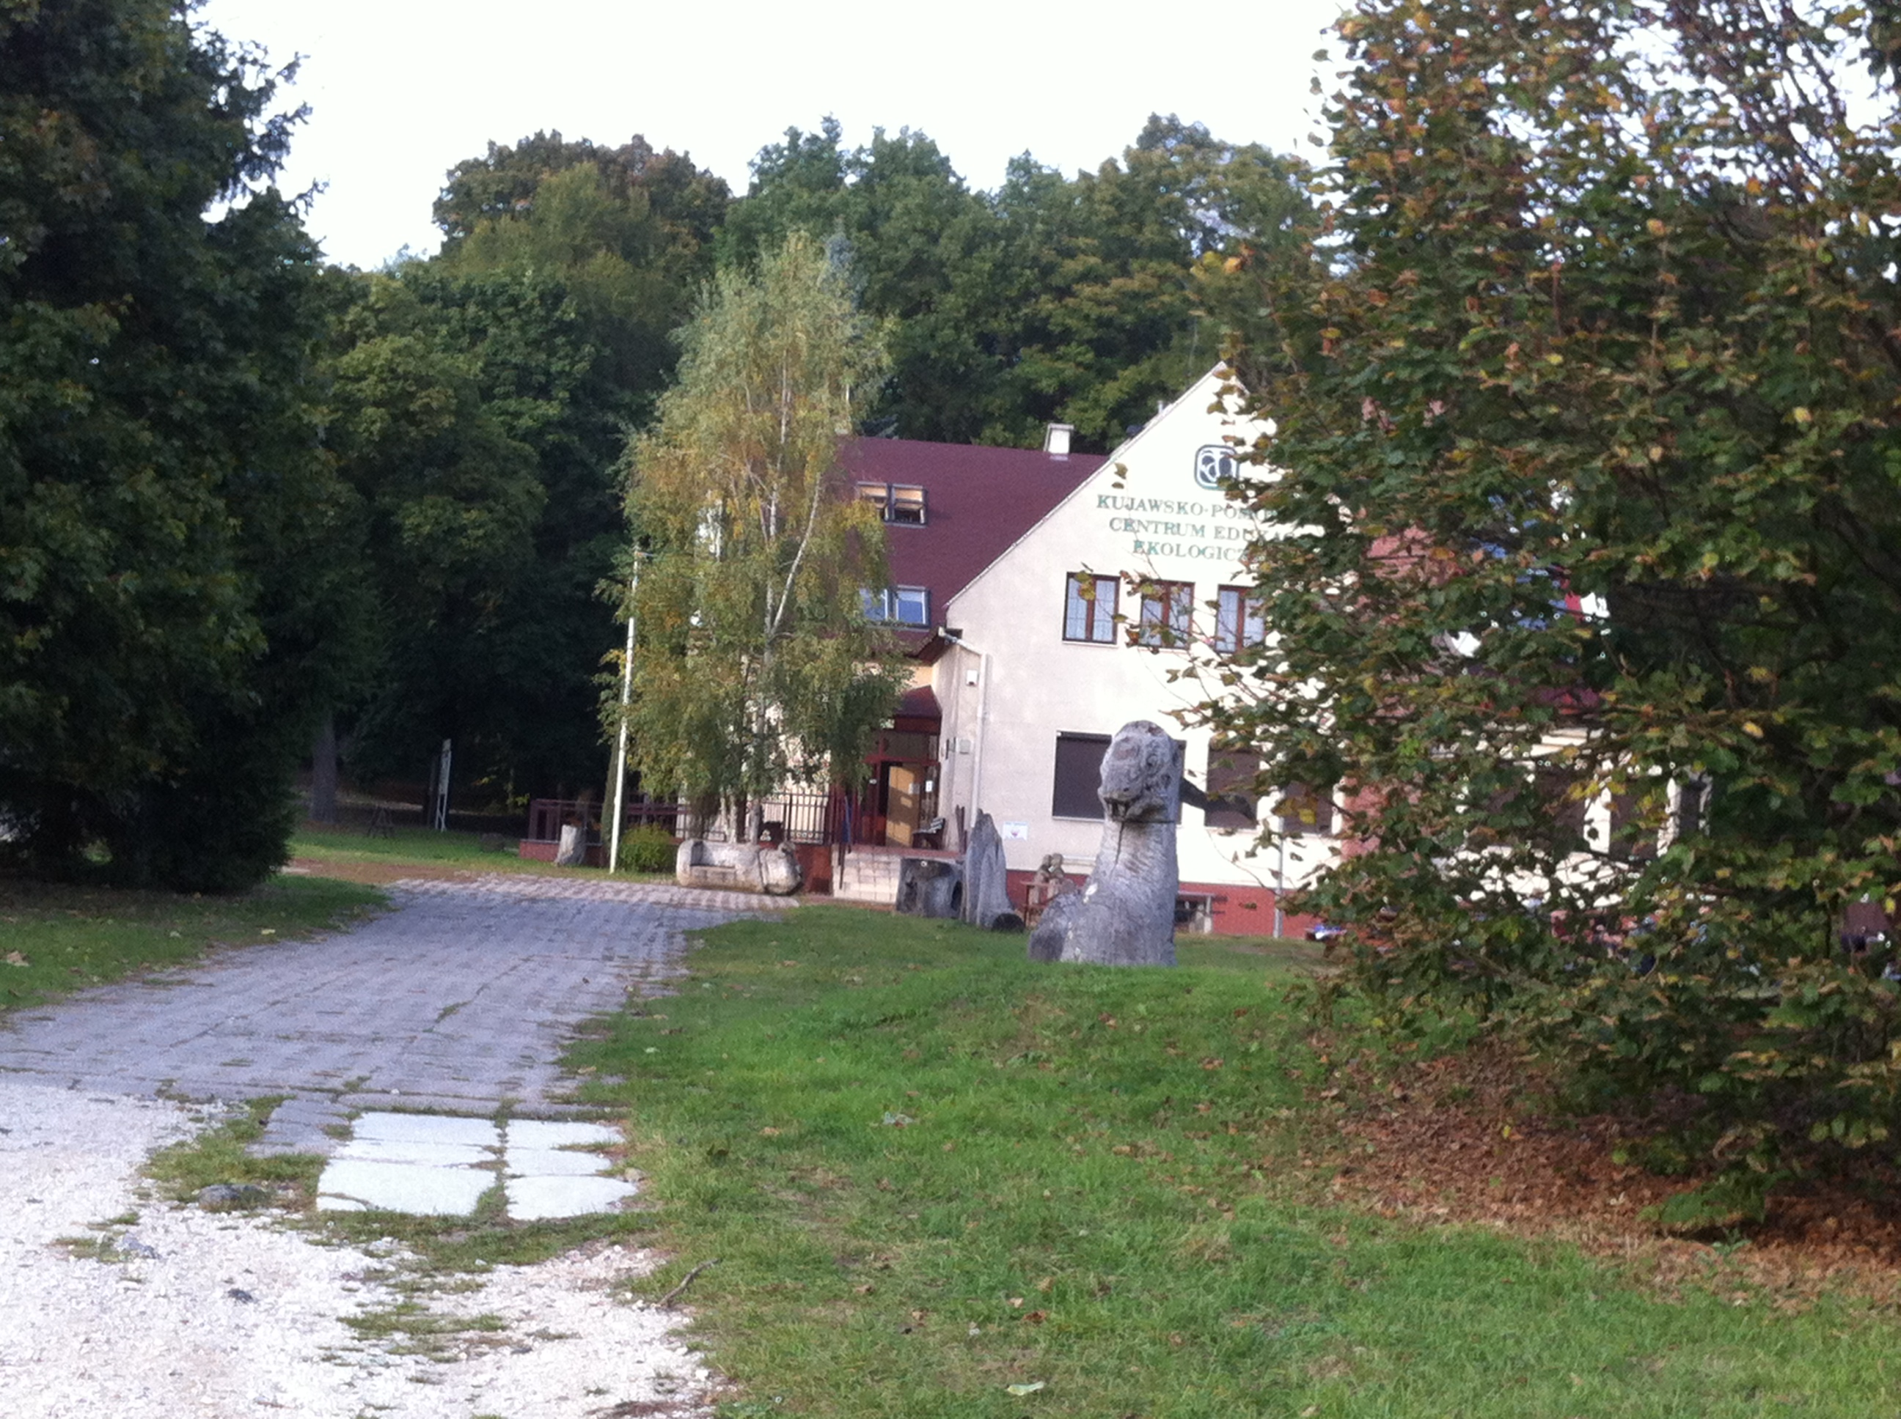
Satirical scene
This picture represents a satirical scene because it shows an empty, lifeless cabin in front of the dark, gloomy and
magical forest.
Monday, September 29th:
Myślęcinek

Slide 5
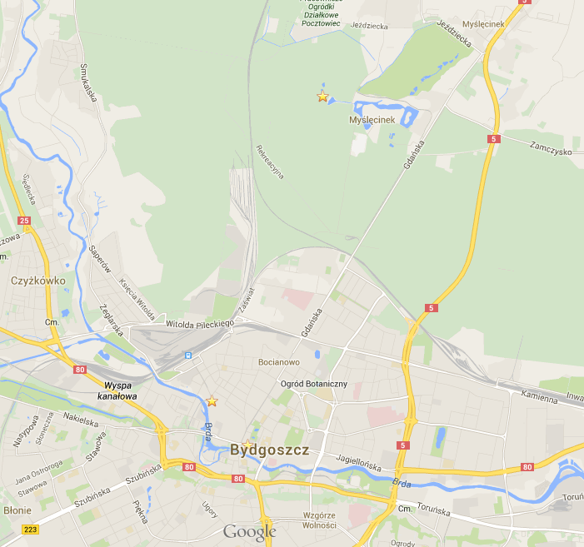
Map of Bydgoszcz with scenes
Satirical scene
Comic Scene
Tragic scene

