Slide 1
My Scenes
By Lydia Birgitte Westlye

Slide 2
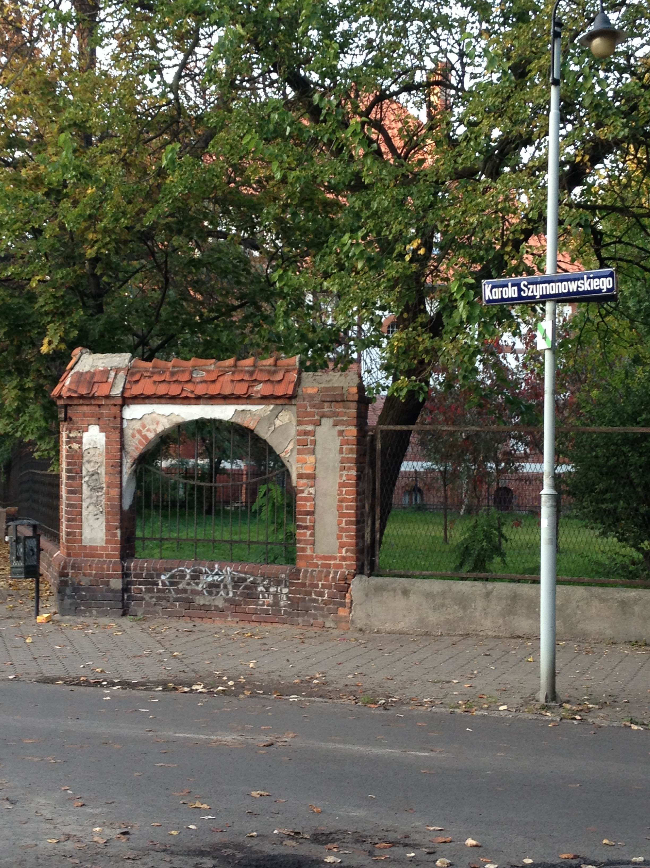
Tragedy
I find this tragic because of all the mystery. It looks tragic and mystic.
It also looks old, which in my
opinion makes it look even more tragic

Slide 3
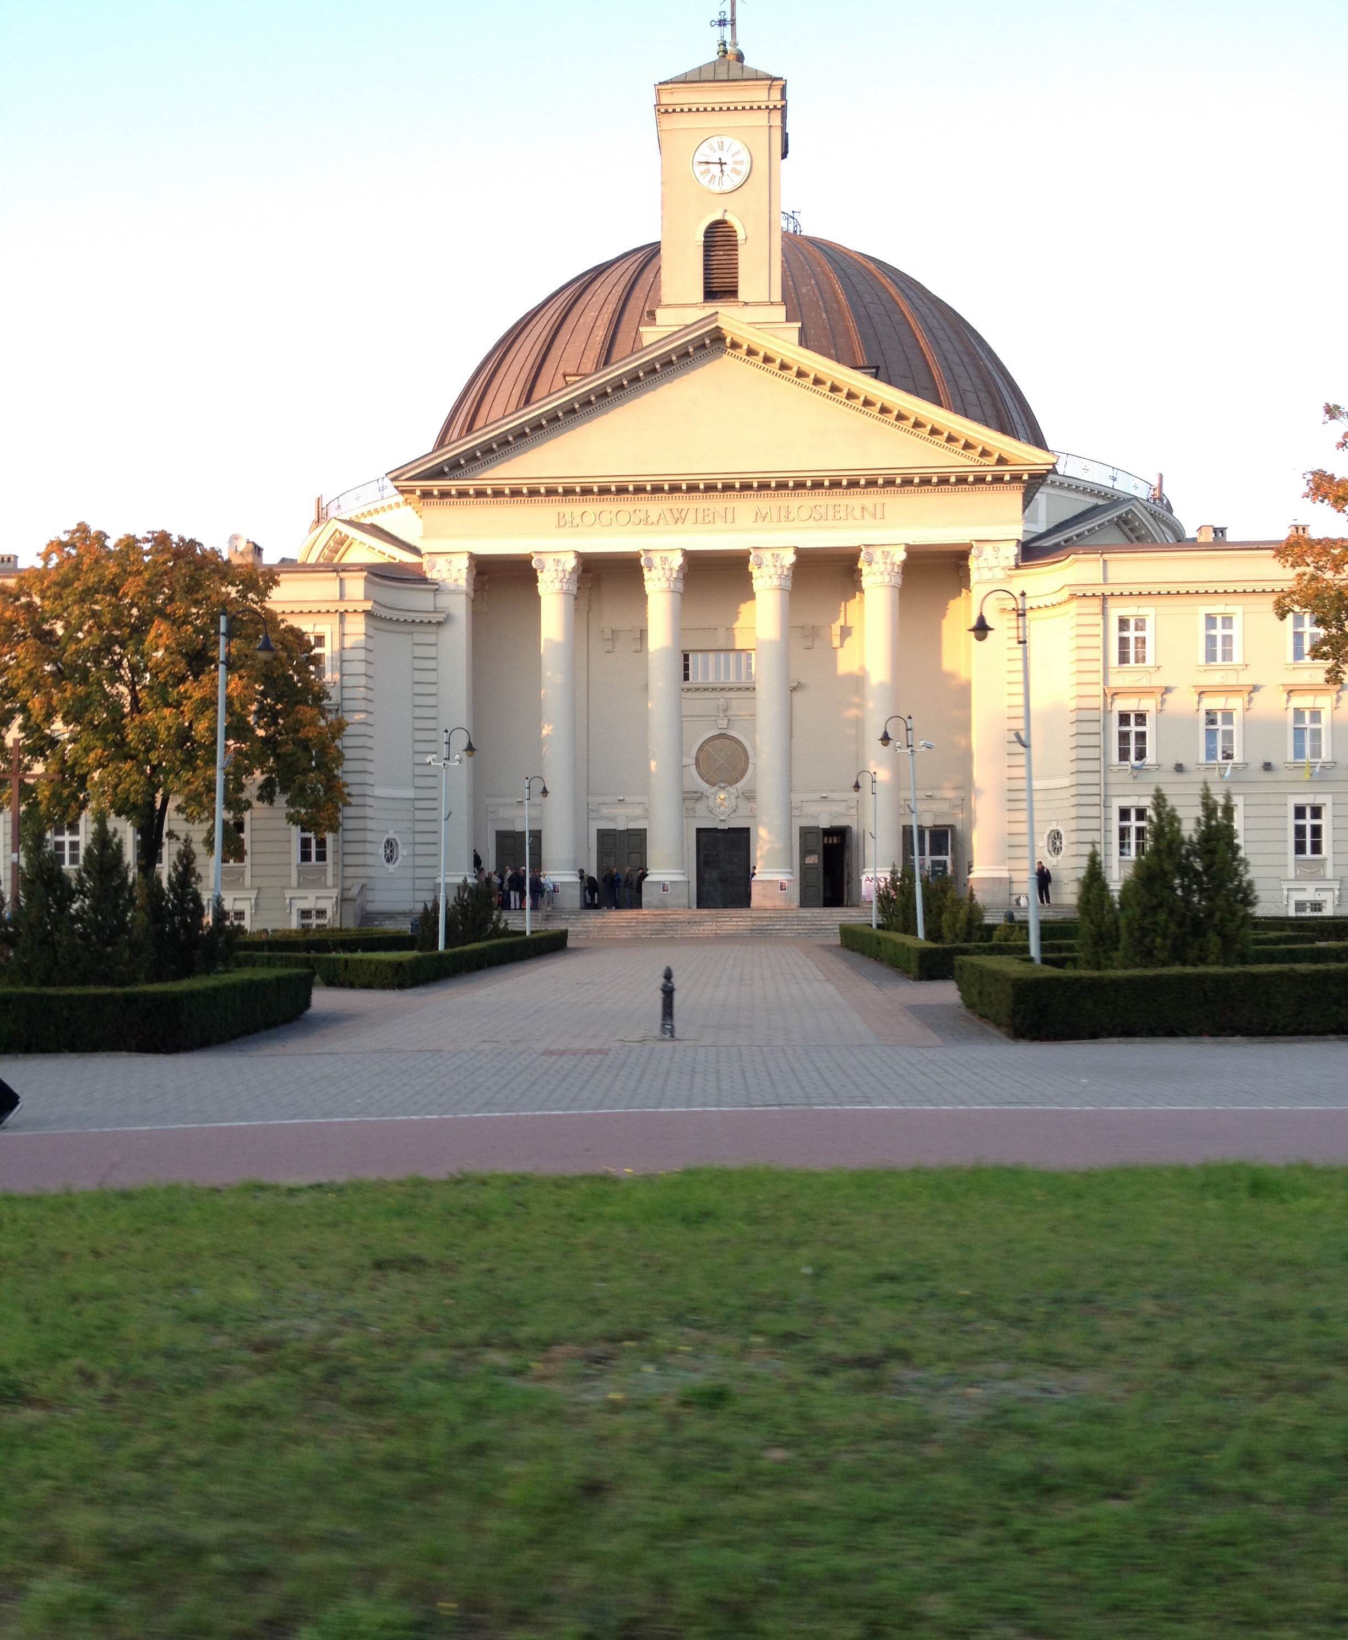
Comedy
Actually, any picture can be put here (in my opinion). Its possible to make jokes about
everything, so why not this?

Slide 4
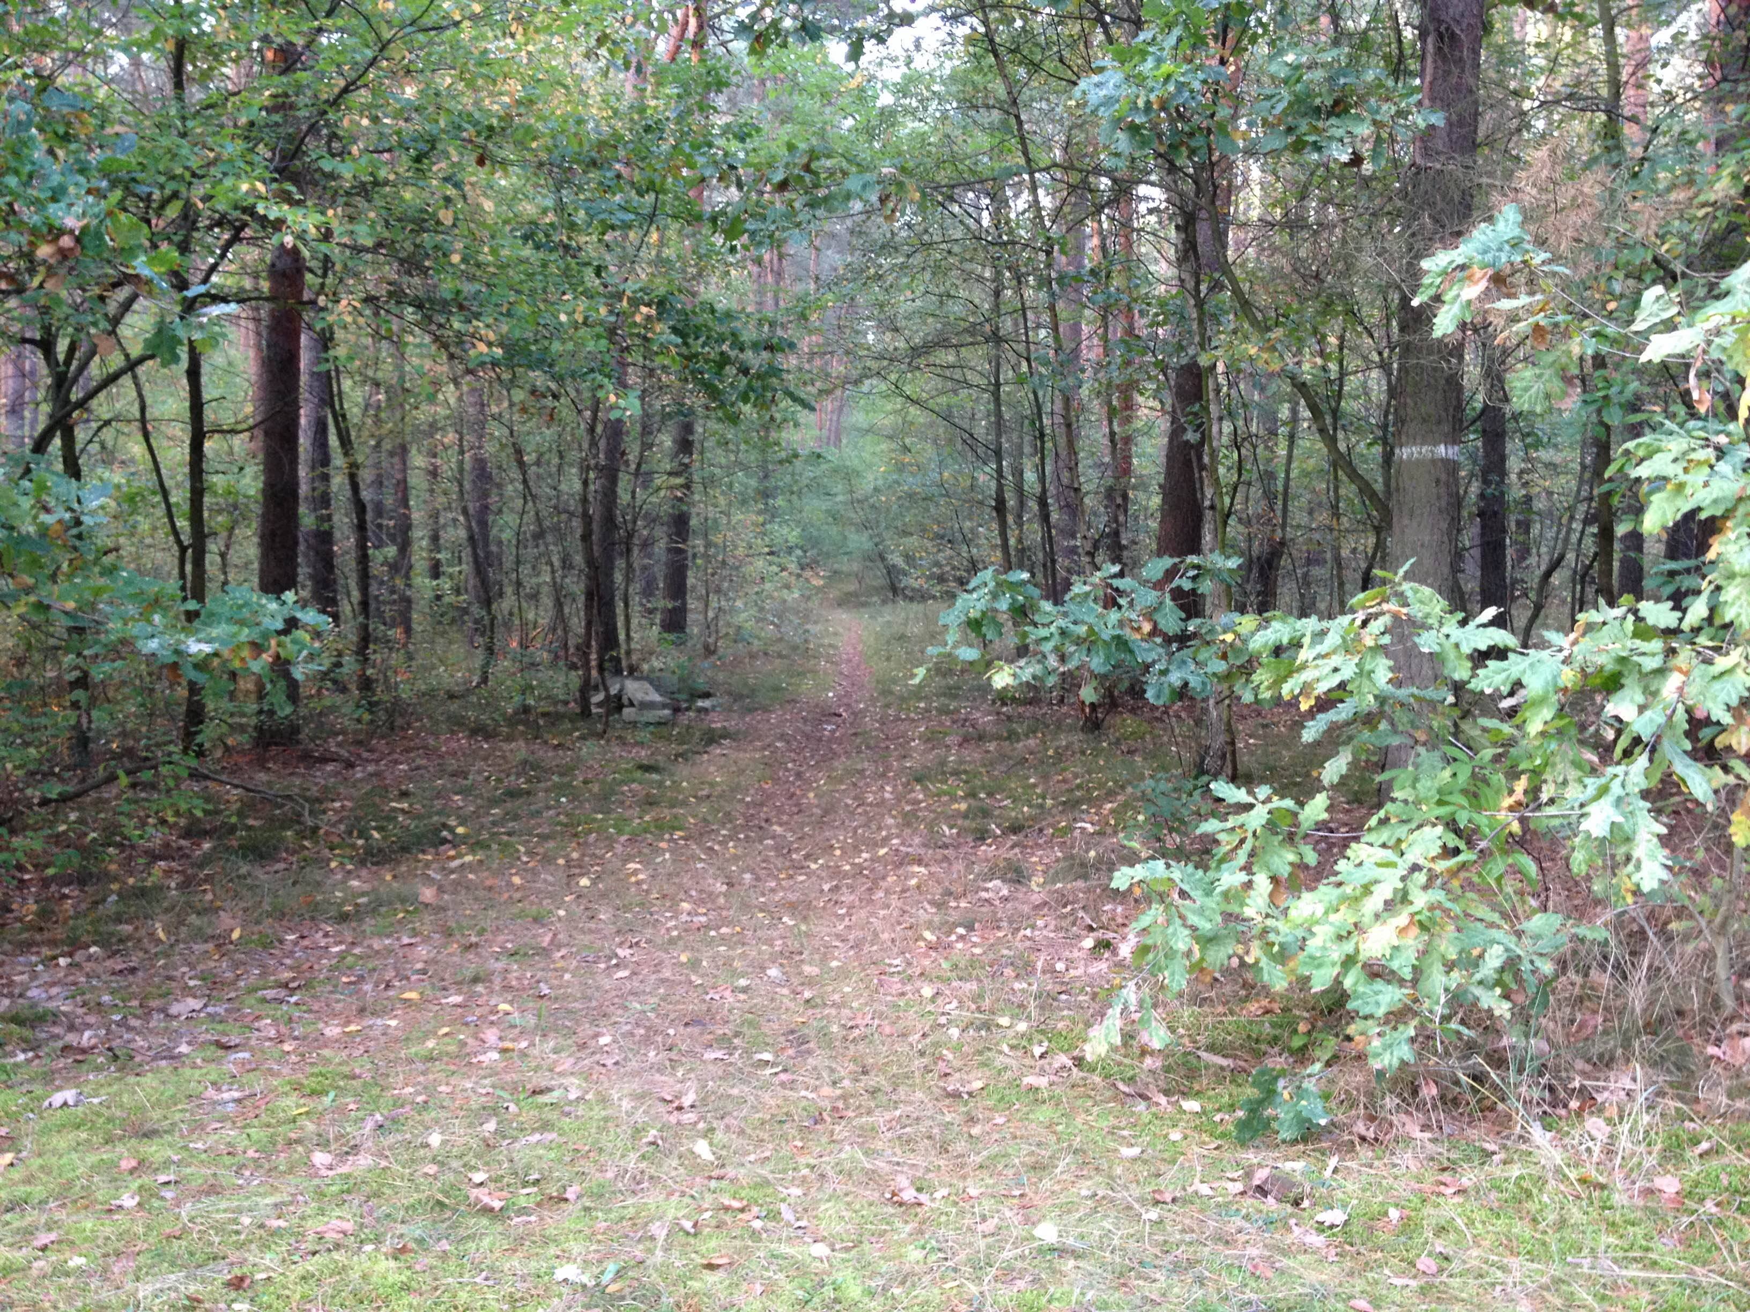
Satyre
Following the paper you gave the class, satirical is supposed to be a stage full of plants. And this is what I could find.

Slide 5
Map
Tragic: Ul. Karola Szymonowskiego
Comic: Księdza Ludwika Sieńki
Satirical: Myślęcinek

