Slide 1
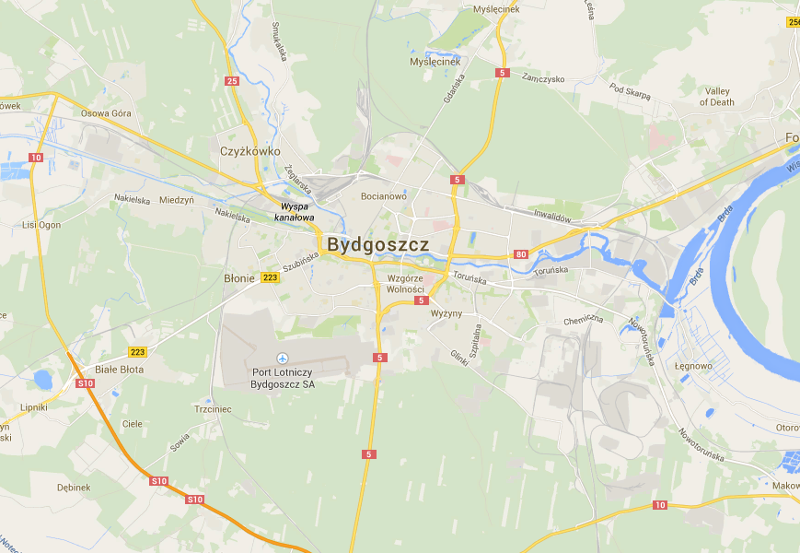
Serlio’s scenes in Bydgoszcz
By Robbie

Slide 2
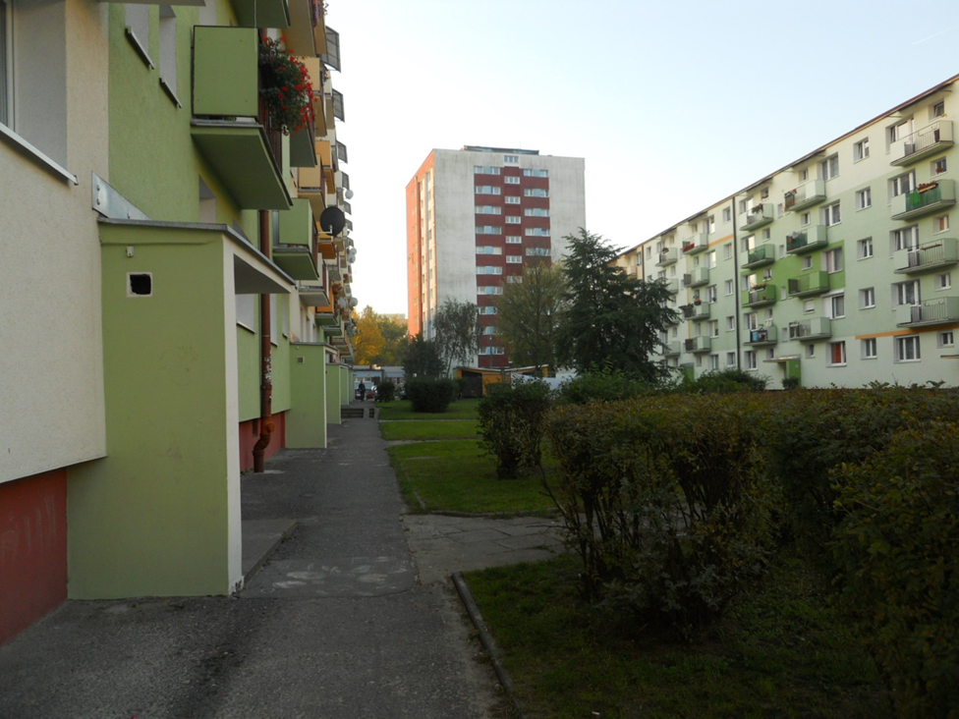

The Comic Scene
Place - Gałczyńskiego 18

Slide 3
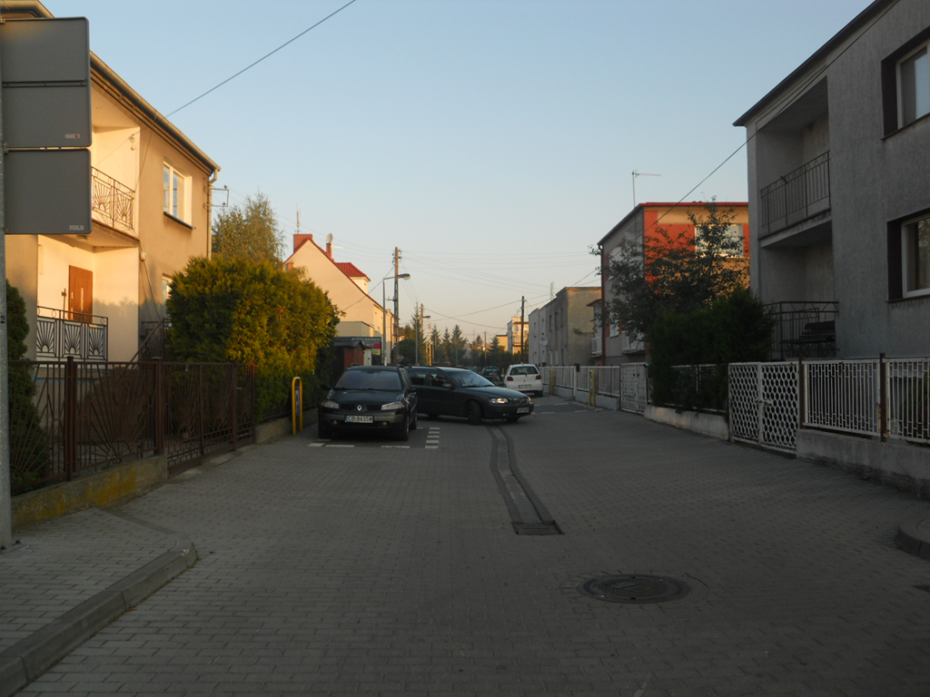
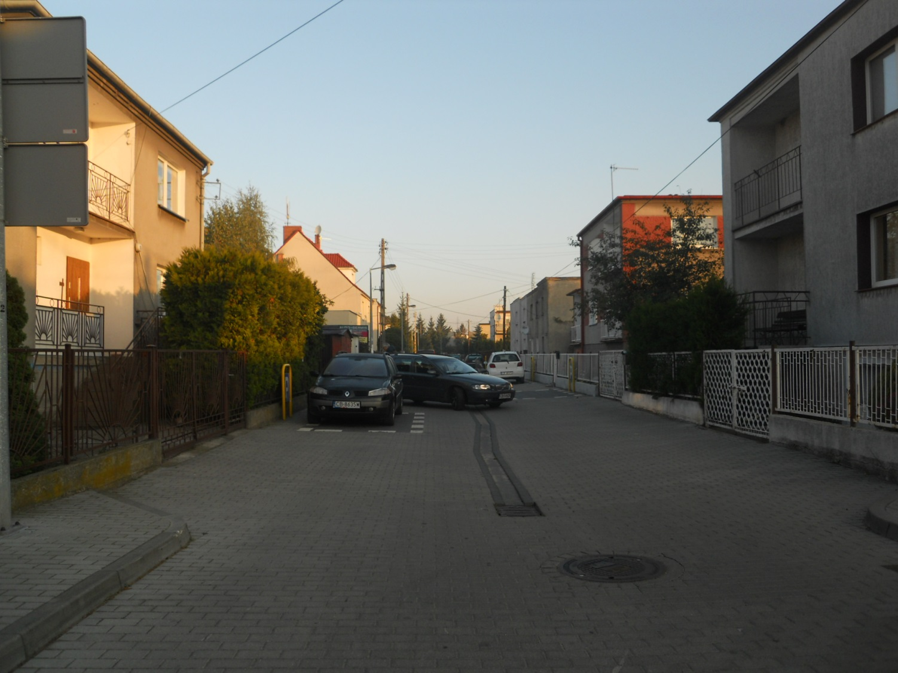
The Tragic Scene
Place - Zakopiańska

Slide 4
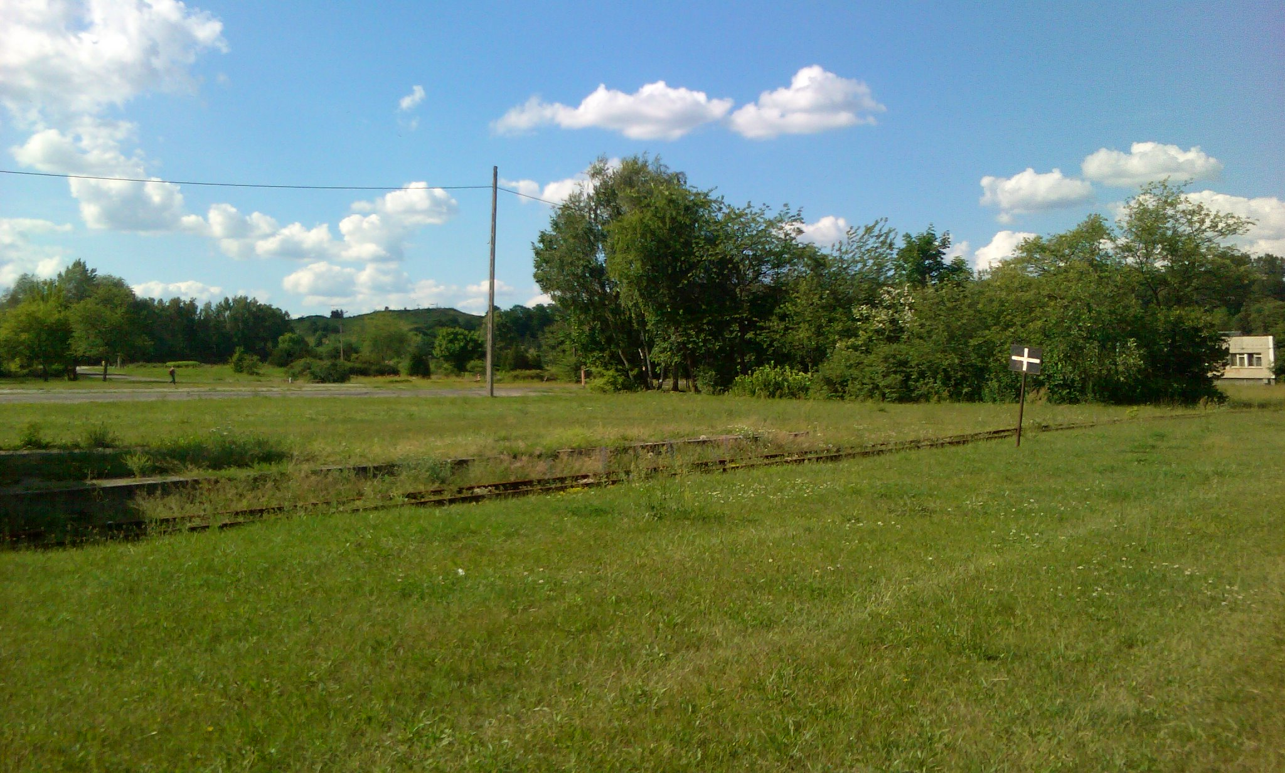
The Satirical Scene
Place - Myślęcinek

Slide 5
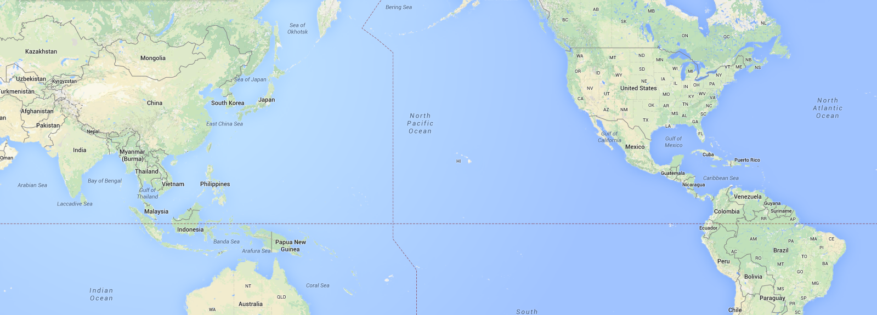
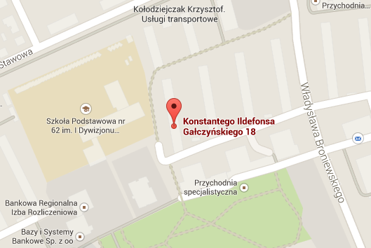
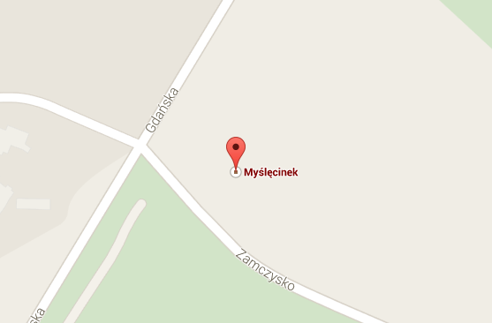

MAP

