Slide 1
Bydgoszcz In The Eyes Of Sebastian Serlio
By Weronika Rejowska

Slide 2
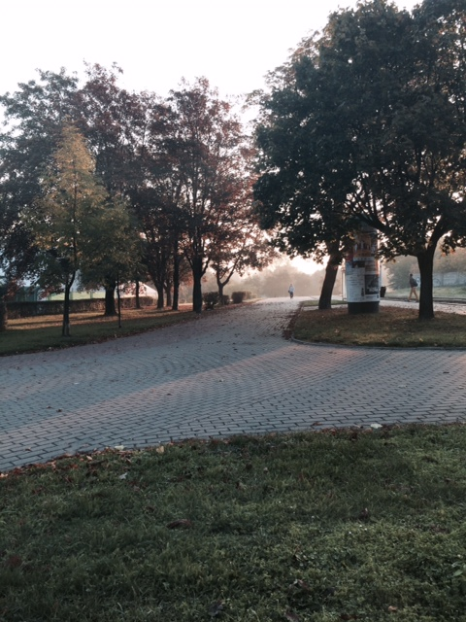
TRAGEDY
05.10.2014
Łuczniczka

Slide 3
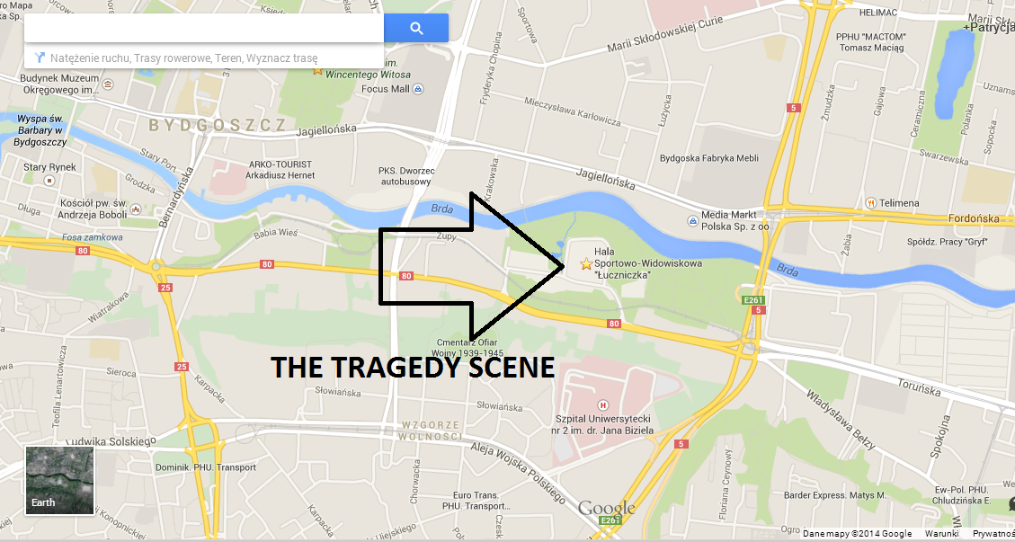

Slide 4
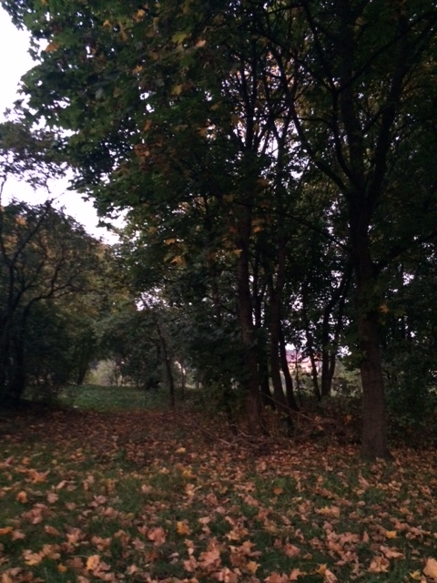
SATYRE
05.10.2014
Forest beside the Animal Shelter

Slide 5
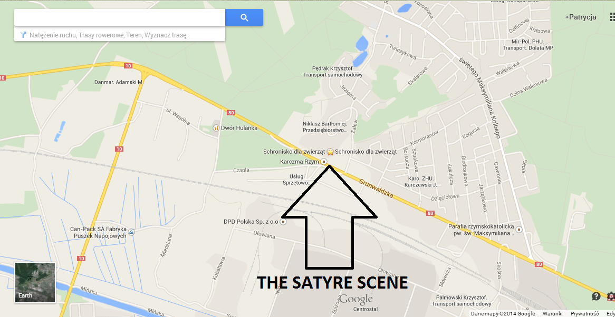

Slide 6
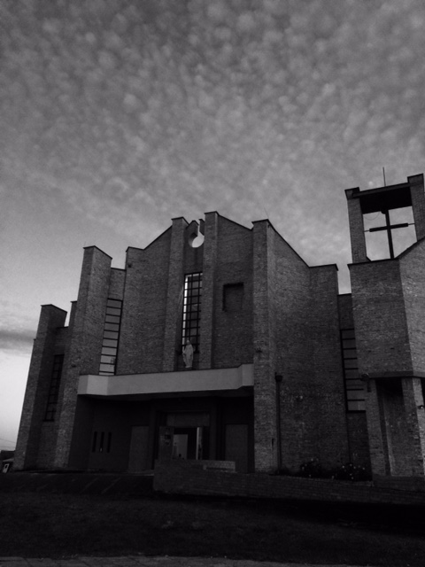
COMEDY
05.10.2014
Church on Str.Glinki

Slide 7
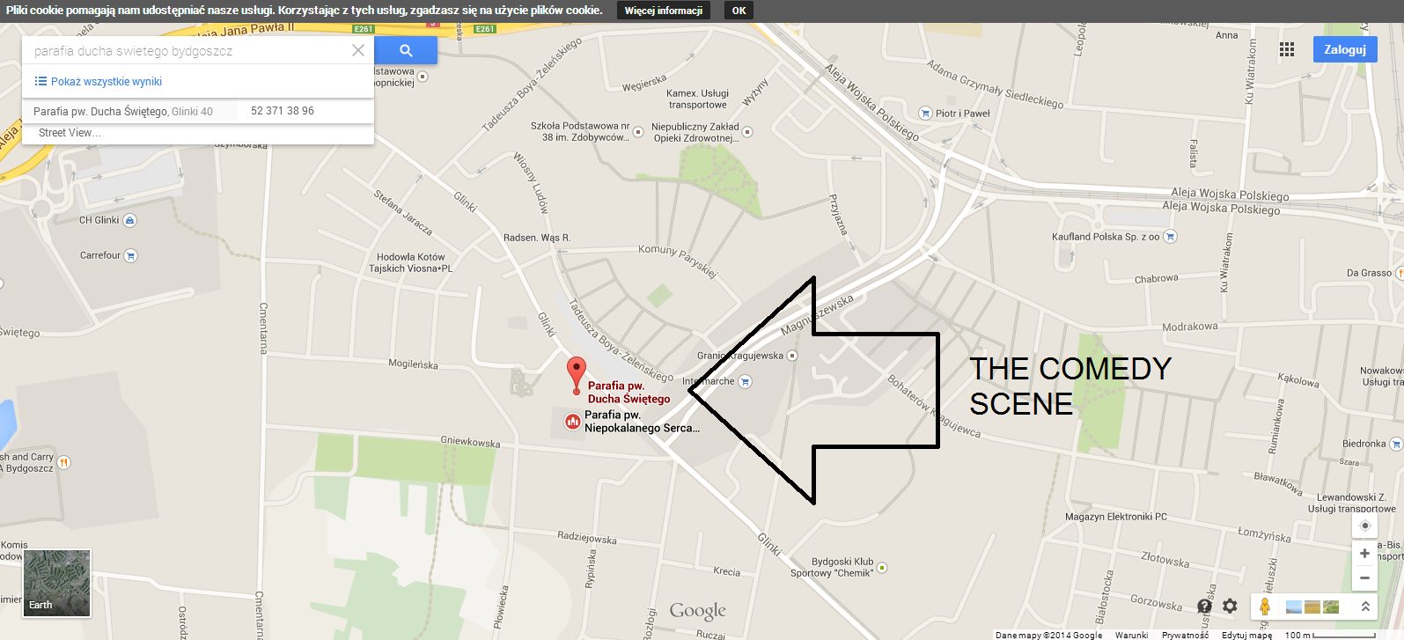

Slide 8
THE END

