Slide 1
Serlio’s Scenes
By: Kovács Kristóf

Slide 2
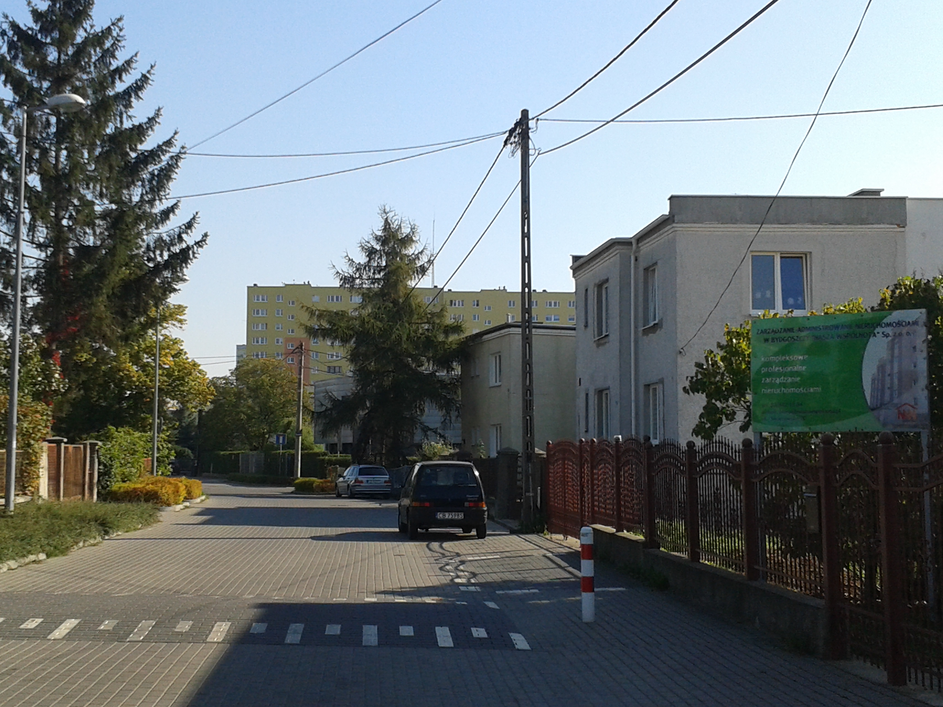
Comic scene
This could be a representative of comic scene because there is street “where houses are slight or citizens”.
ul. Swarzewska, 04.10.2014

Slide 3
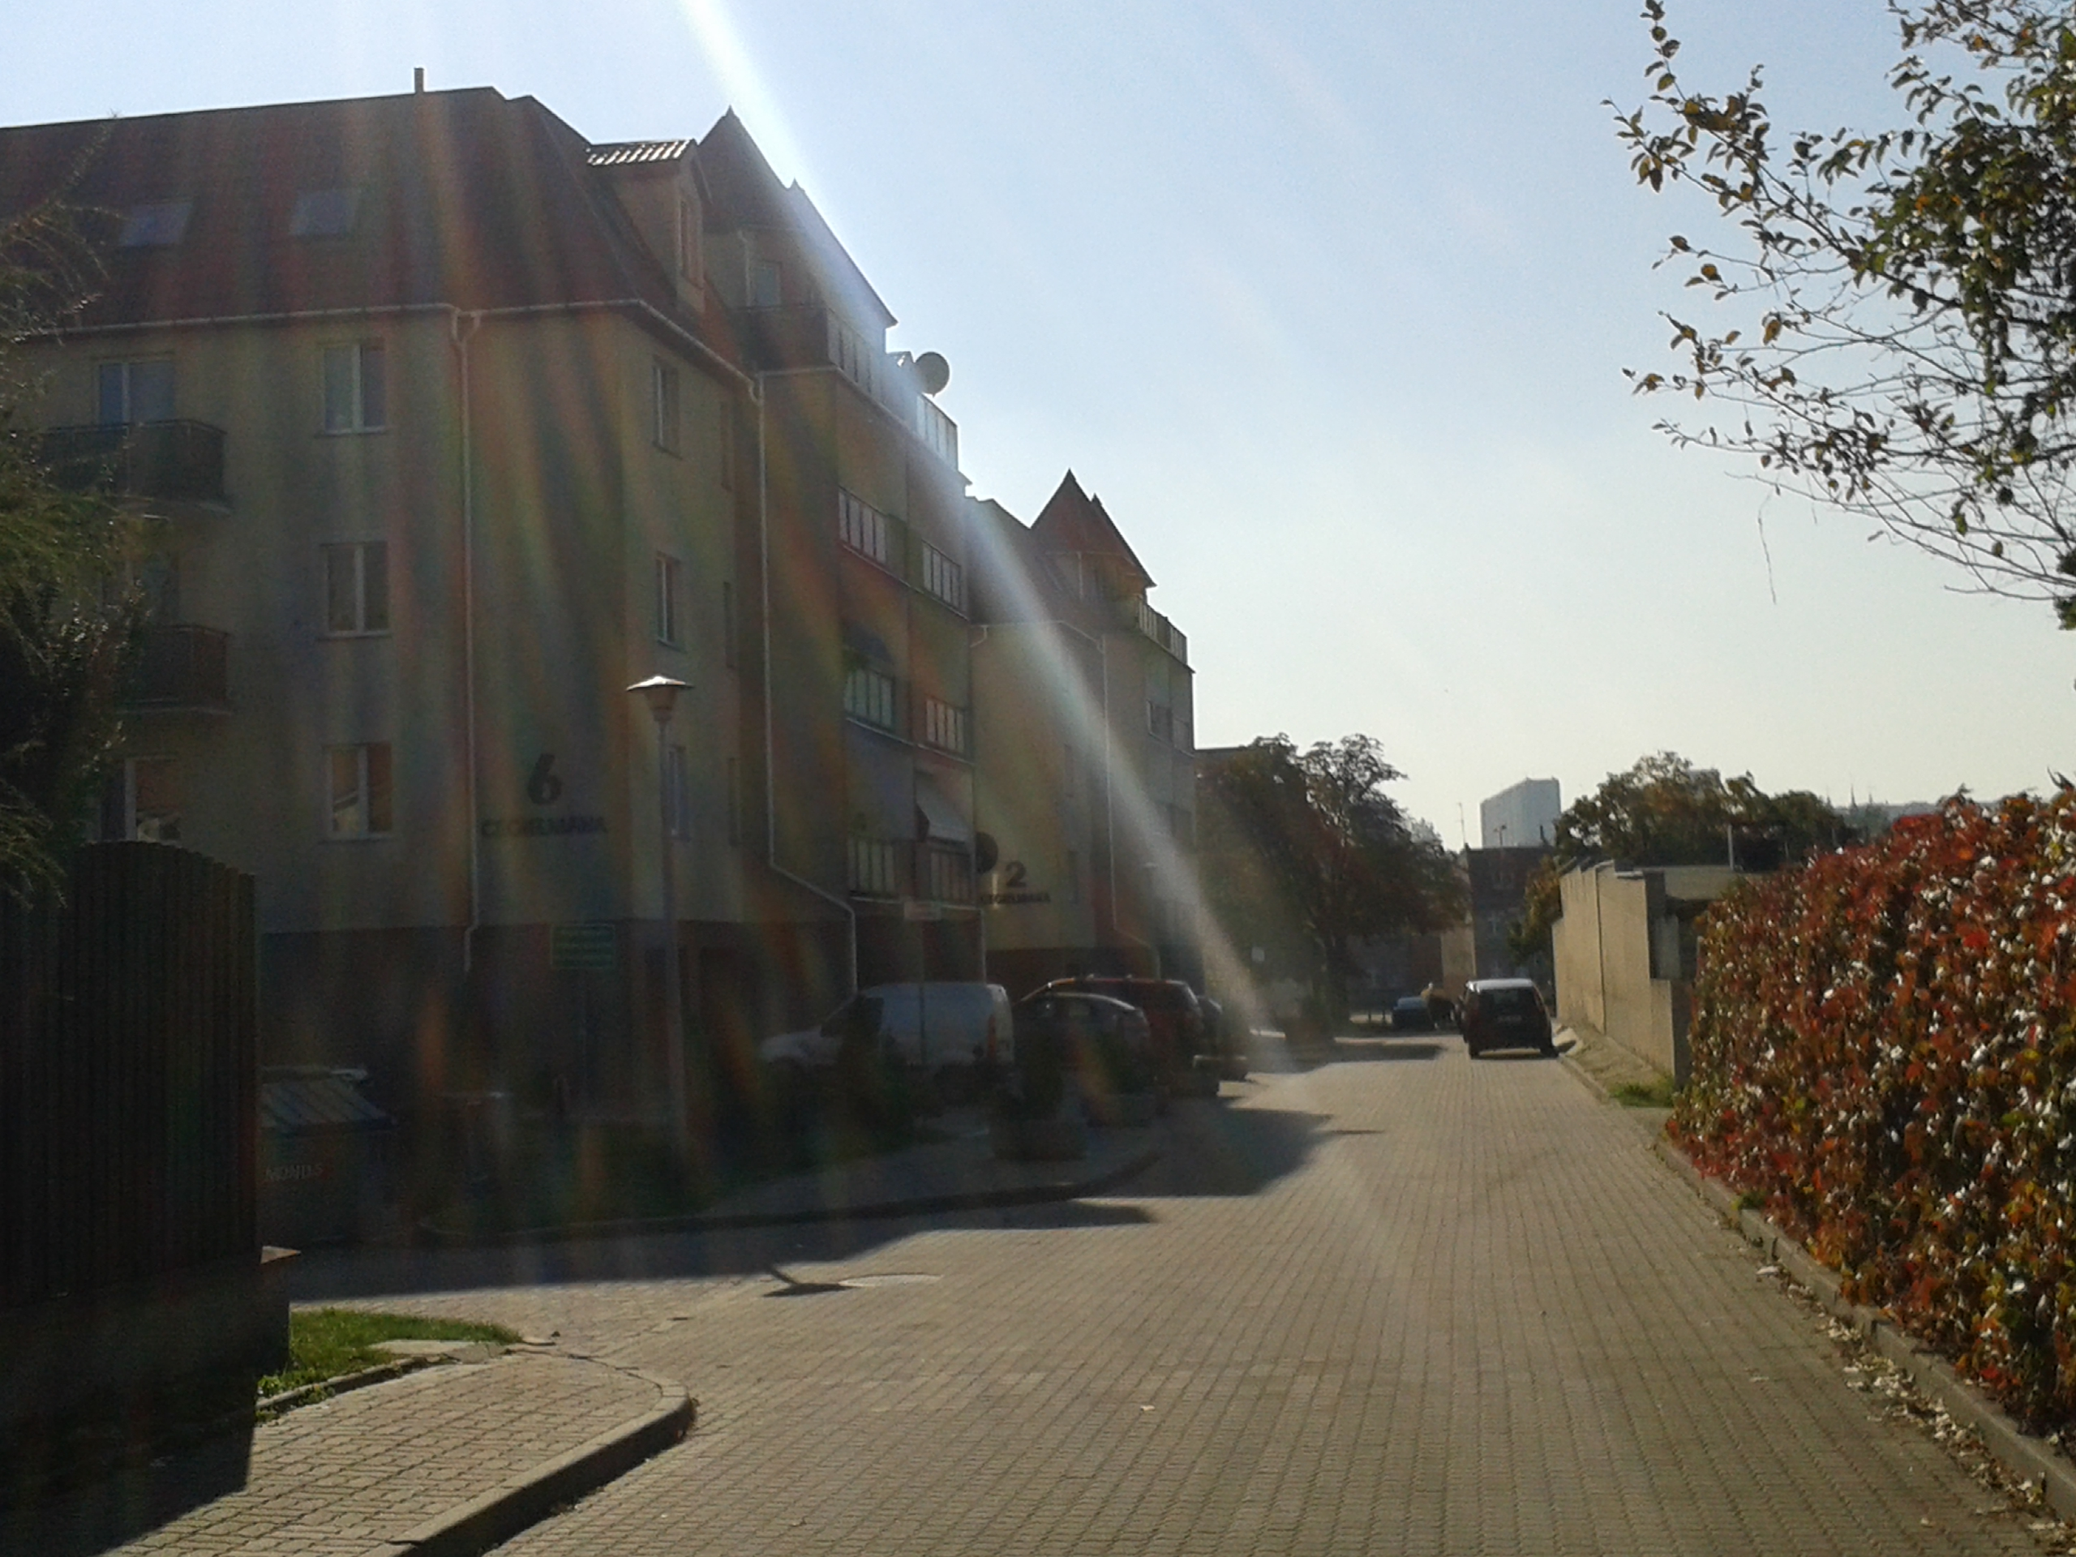
Tragic scene
This could be a place for tragic scene because the colourful, nice houses with a tower at the background.
      04.10.2014, ul. Bałticka

Slide 4
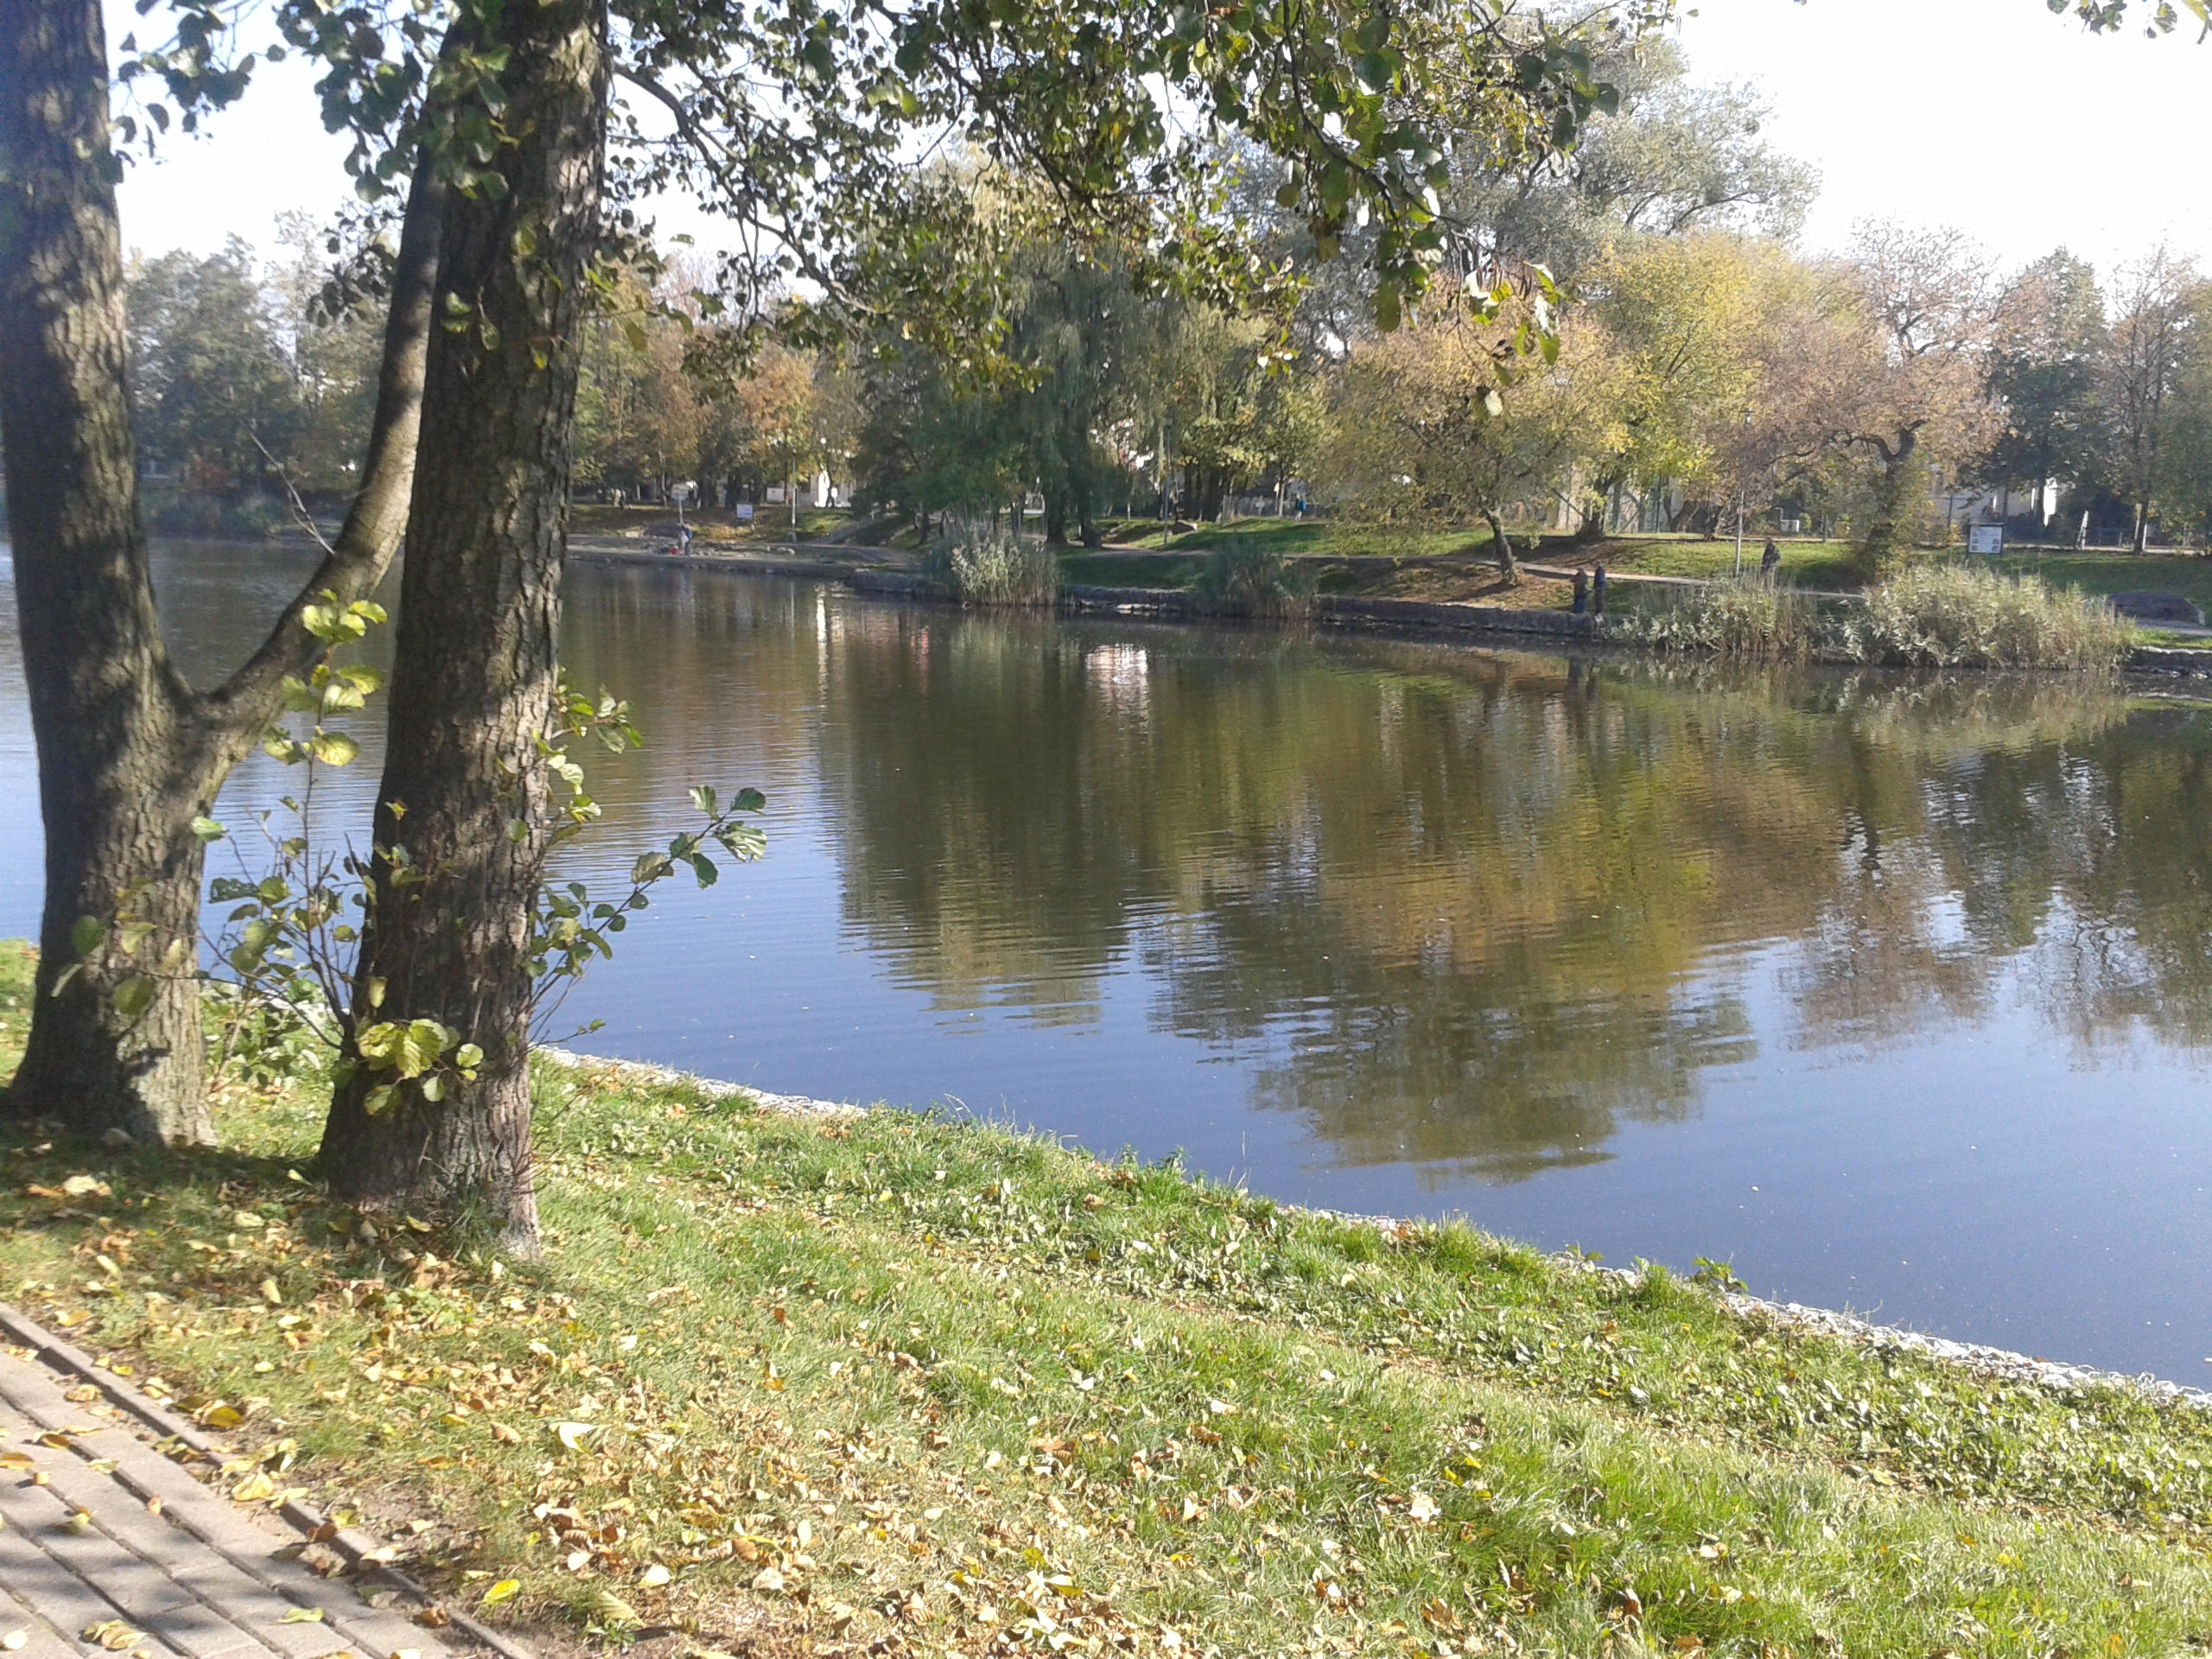
Satirical scene
It is a satirical scene because of the lake with the trees, flowers and bushes.
      04.10.2014, Park przy Balatonie

Slide 5
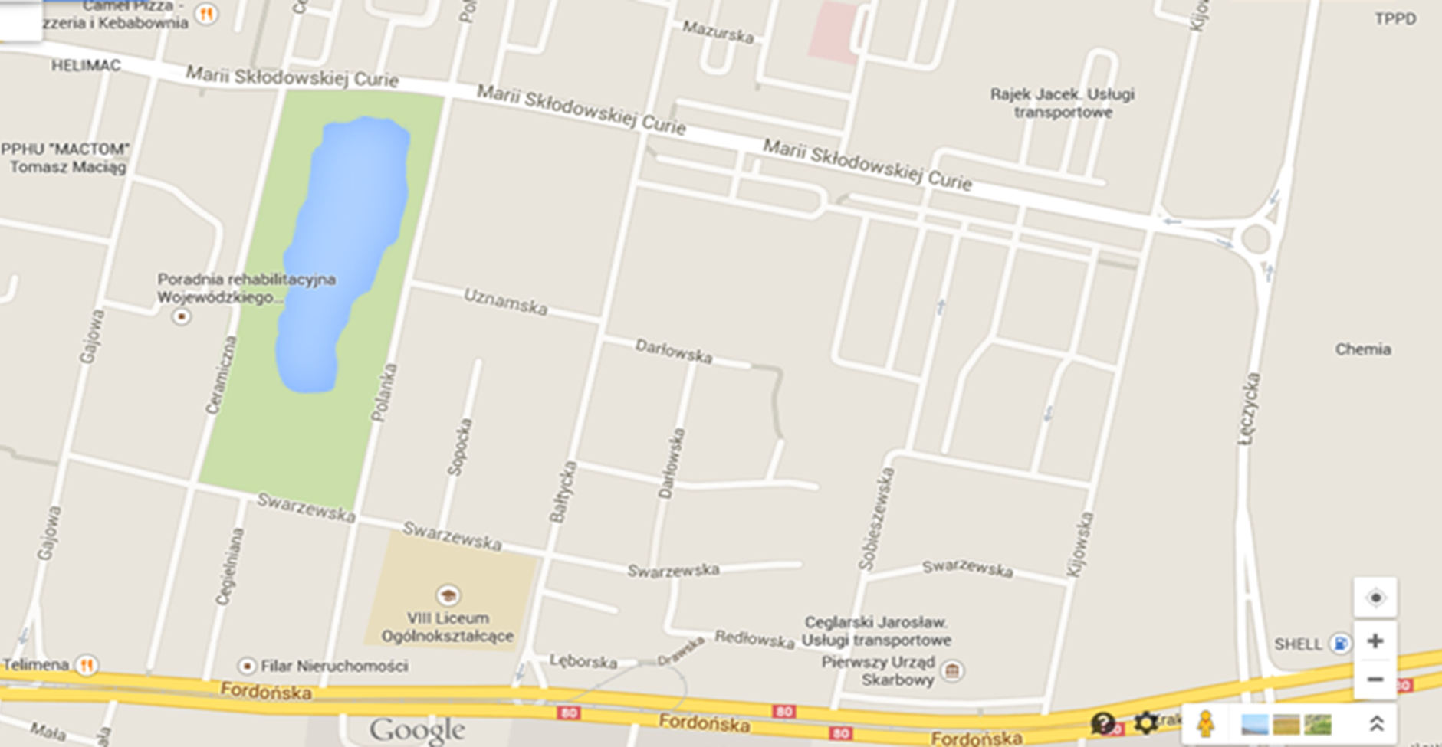
Satirical scene
Comic scene
Tragic scene

