Slide 1
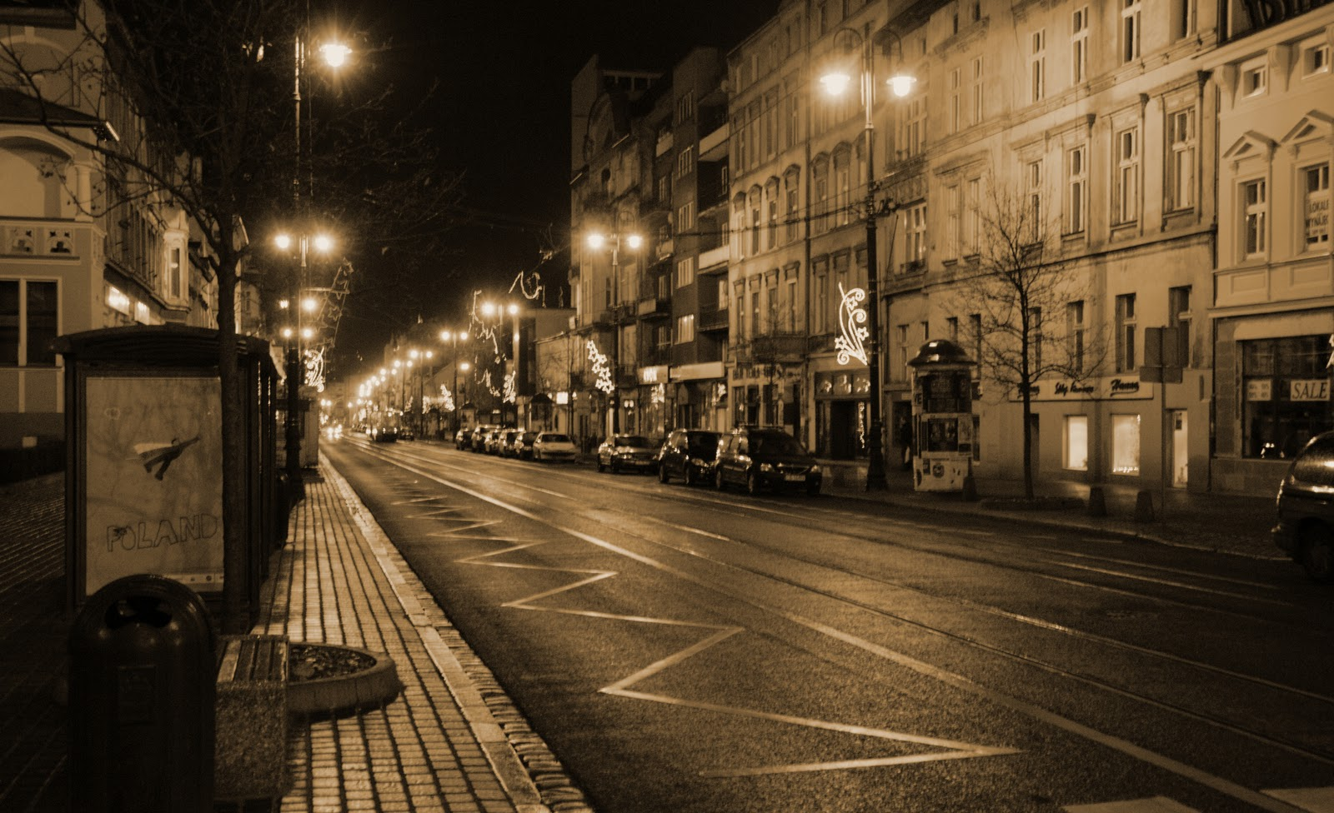
Bydgoszcz in the Eyes of Sebastian SerLio
(Photos taken by natalia patelka from g8 class. only photos from the first and the last slide are not mine)

Slide 2
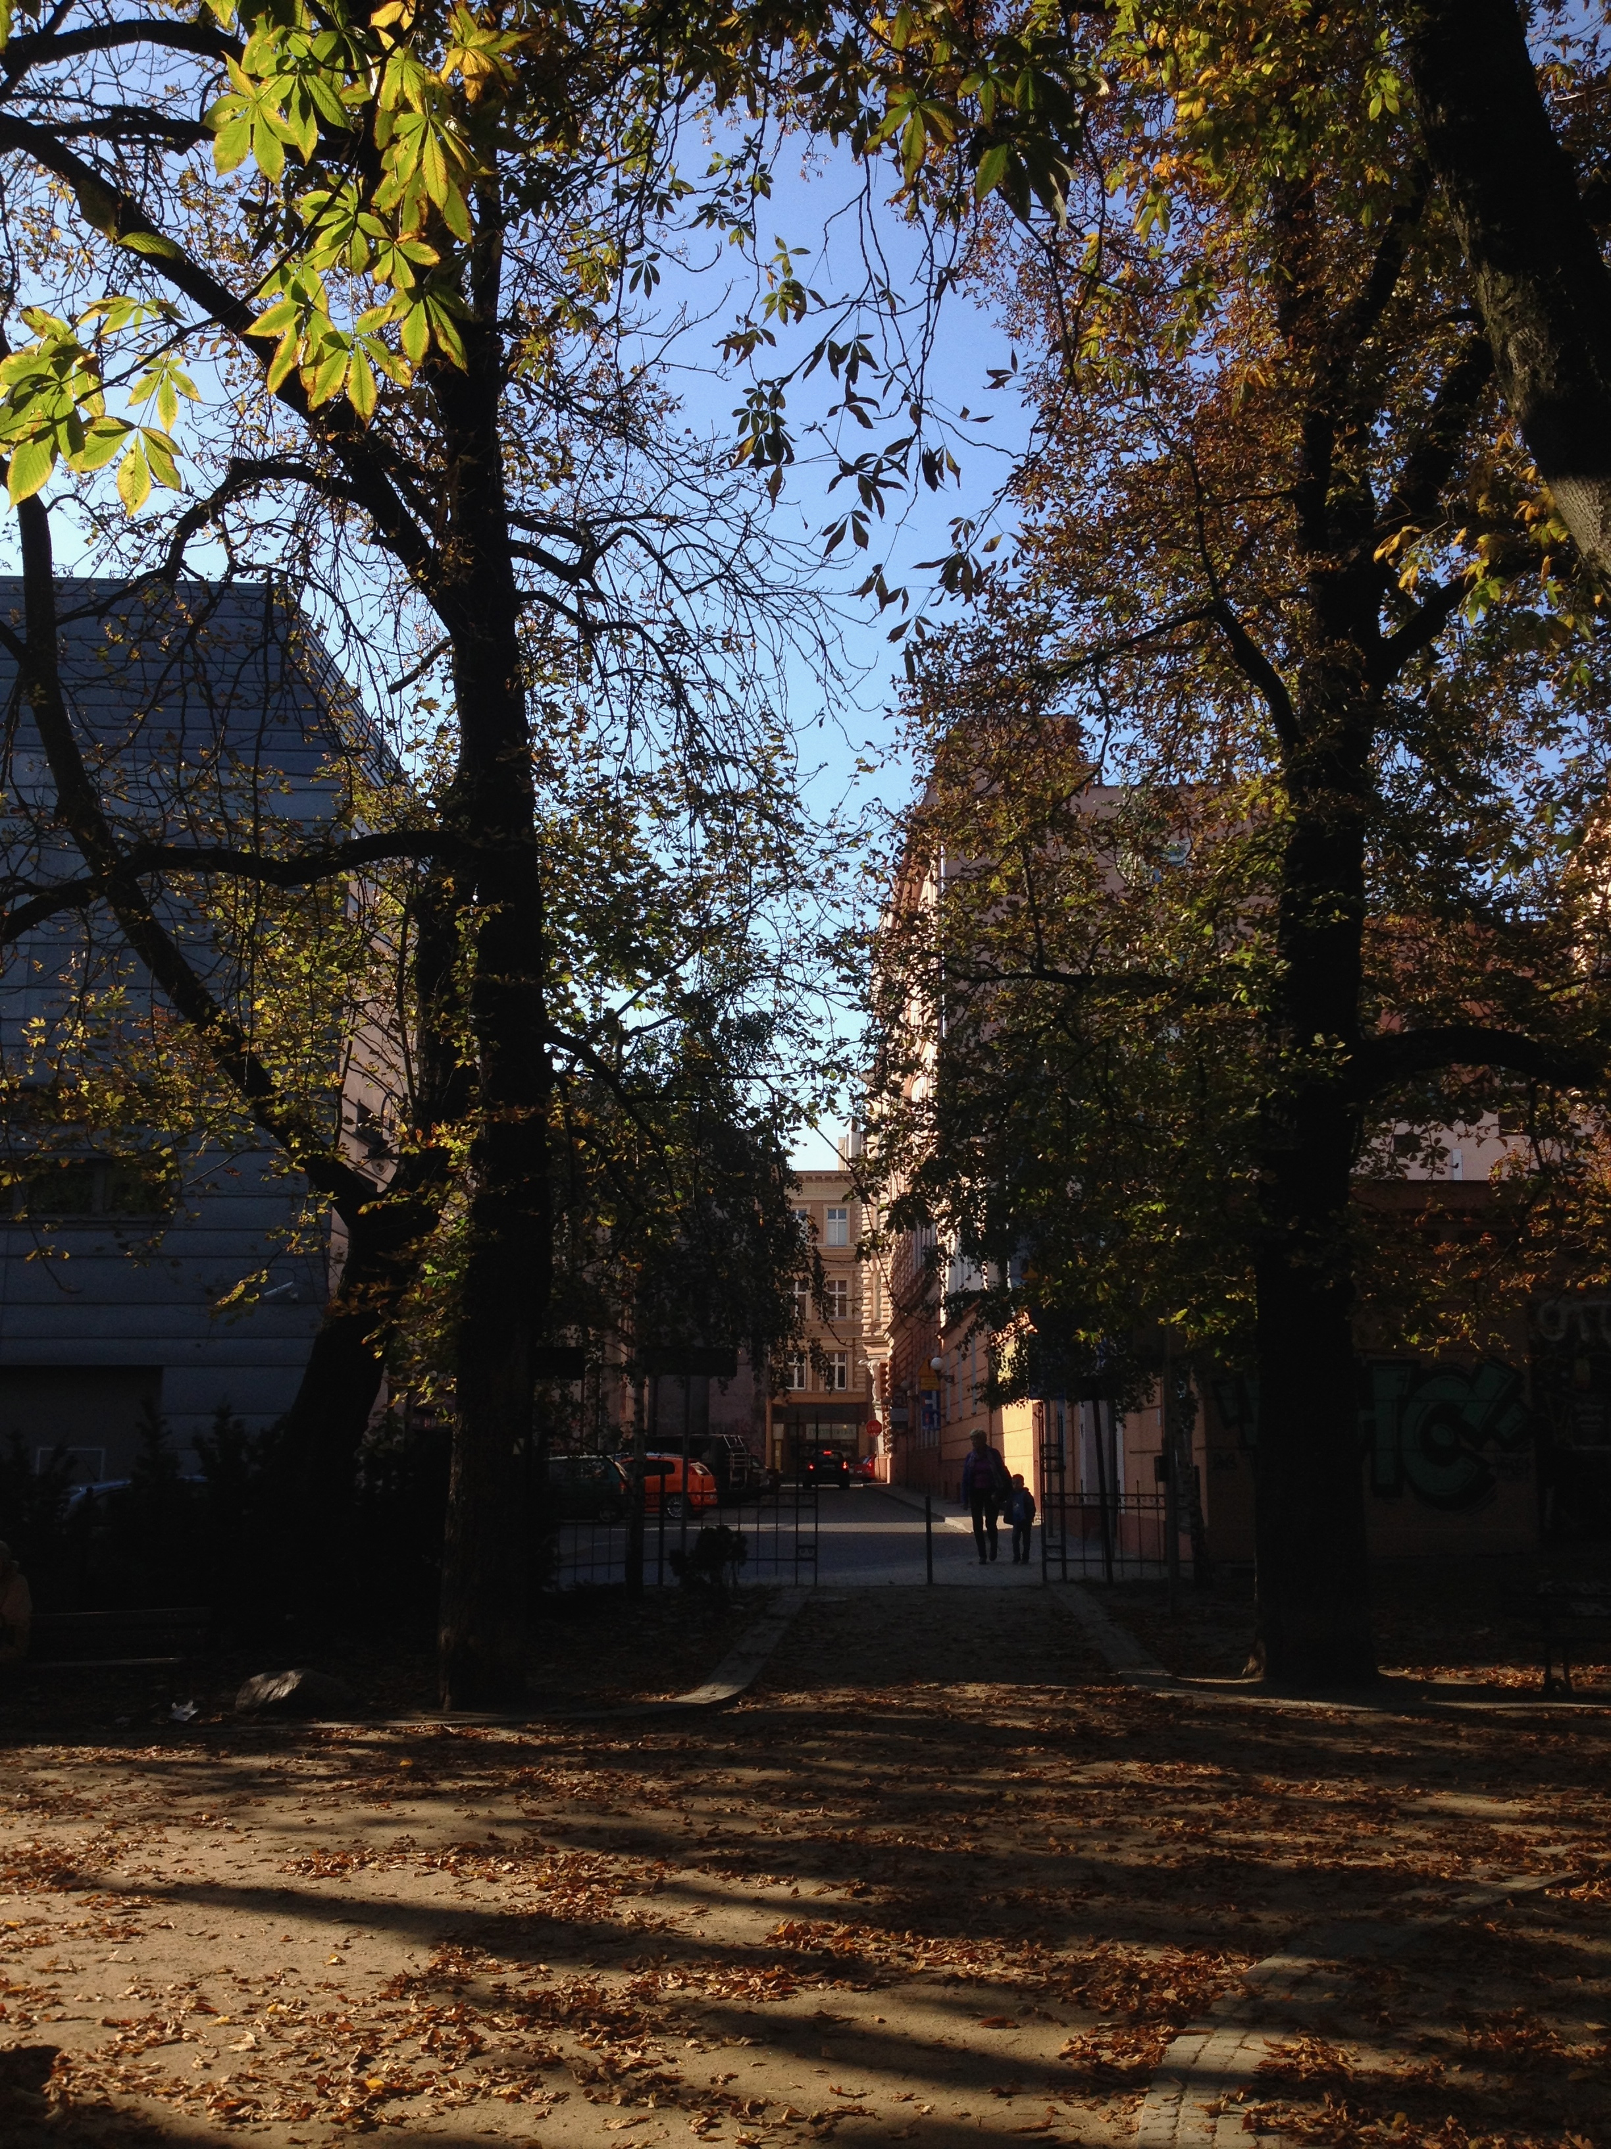
Tragedy
The Kazimierz Wielki Park
05.10.2014

Slide 3
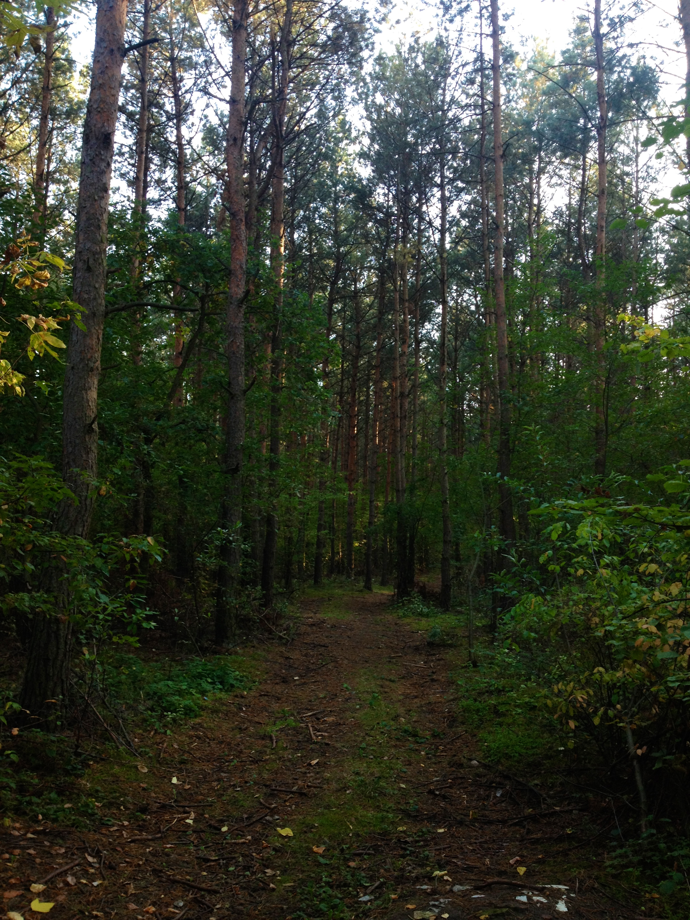
SATYRE
The Forest at Glinki District
05.10.2014

Slide 4
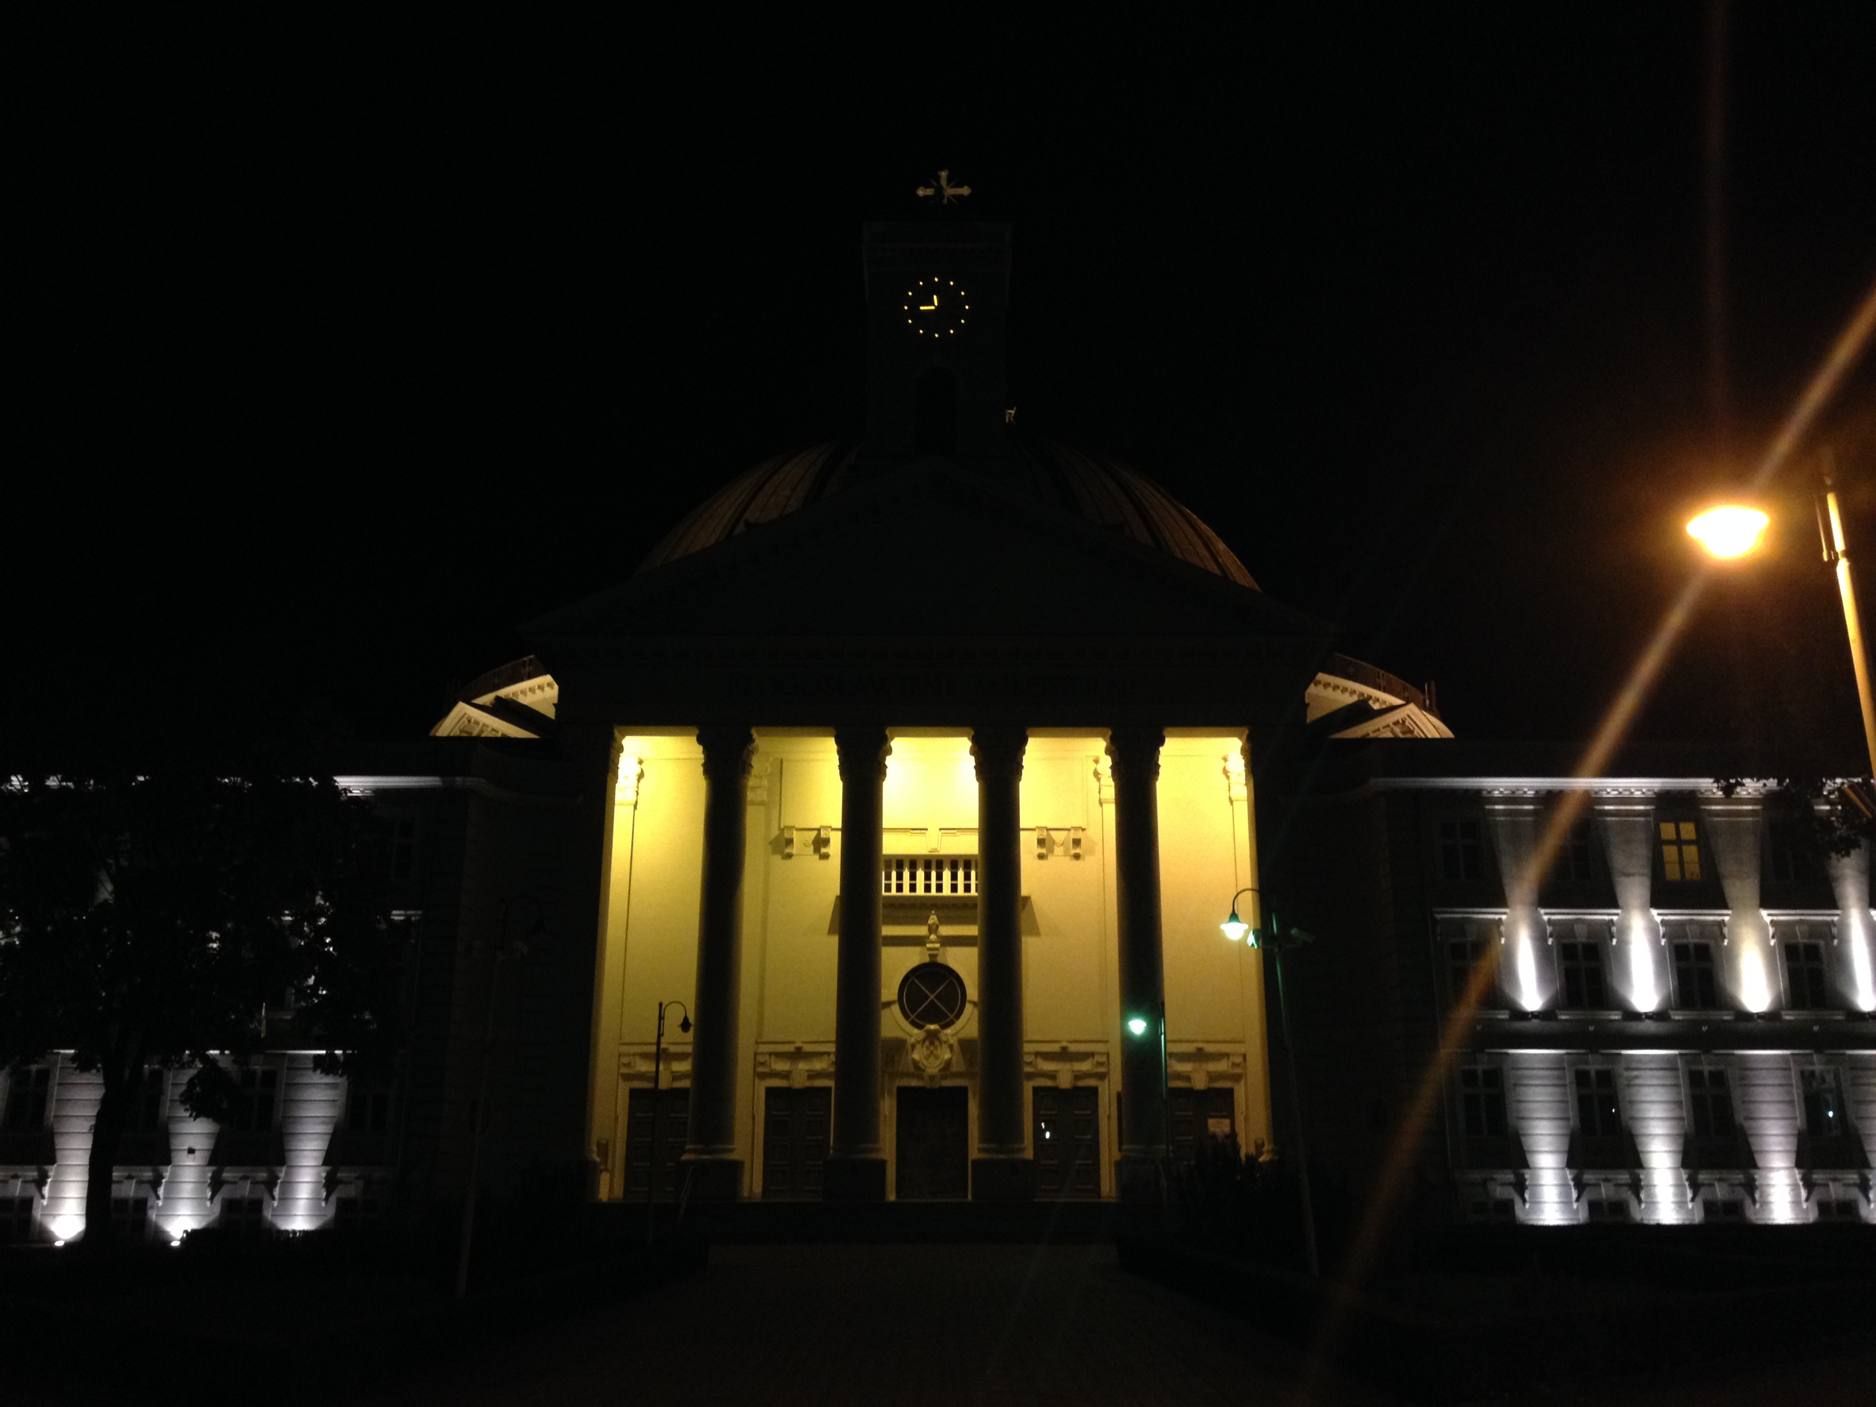
COMEDY
The Basilica Church in the night 05.10.2014

Slide 5
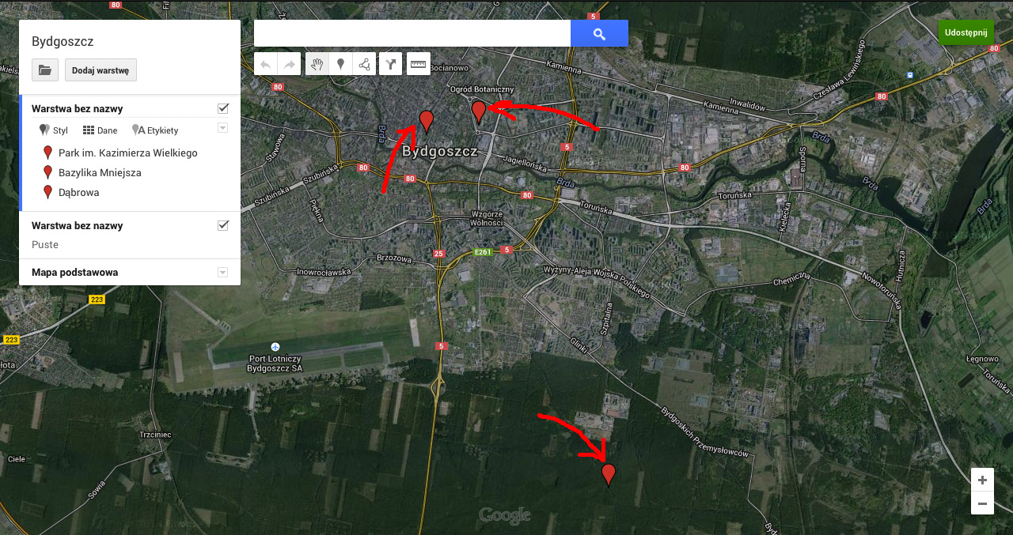
THE MAP OF BYDGOSZCZ WITH PLACES FROM THE PRESENTATION
The Basilica Church
Kazimierz Wielki Park
The Forest at Glinki Discrict

Slide 6
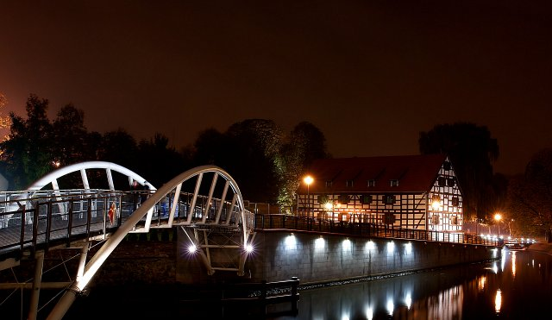
THE END

