Slide 1
The Comic scene ,the tragic scene and Satirical scene
By:Aron

Slide 2
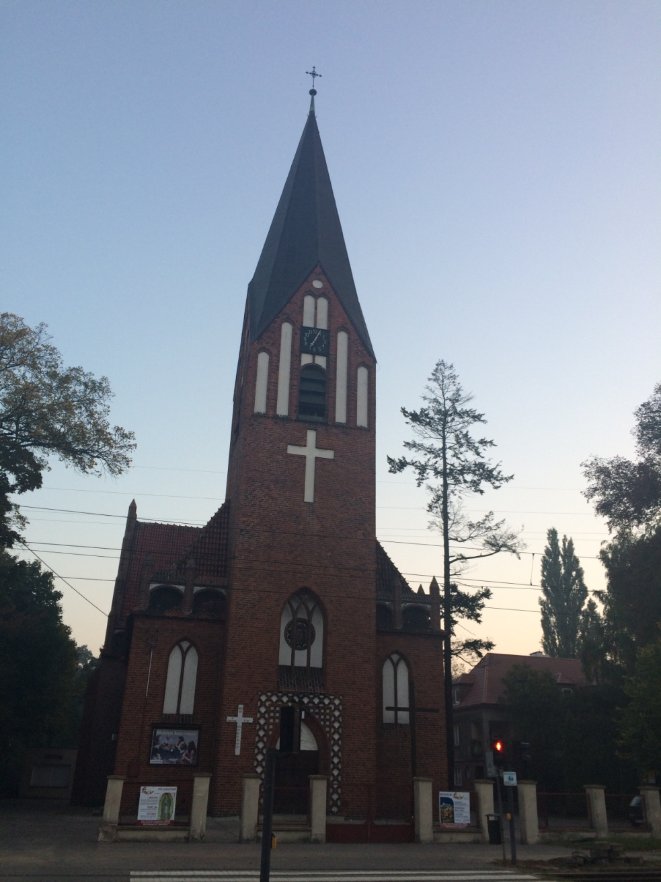
The Comic scene
This picture was taken on Nakielska street. I think it maching to the Comic scene ,because in the Comic street there is nearly always church.

Slide 3
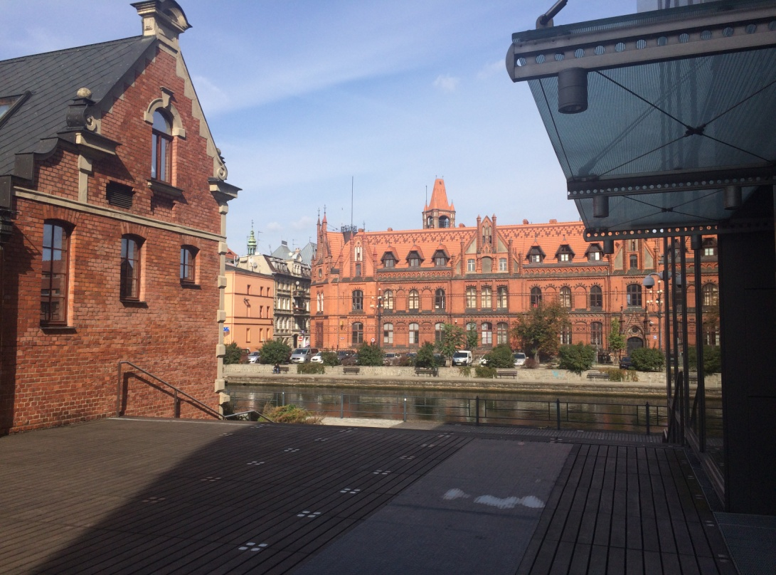
The Tragic scene
This picture was taken on Stary rynek. I think it is maching to the Tragic scene, because the hauses are looking as a lord s hauses.

Slide 4
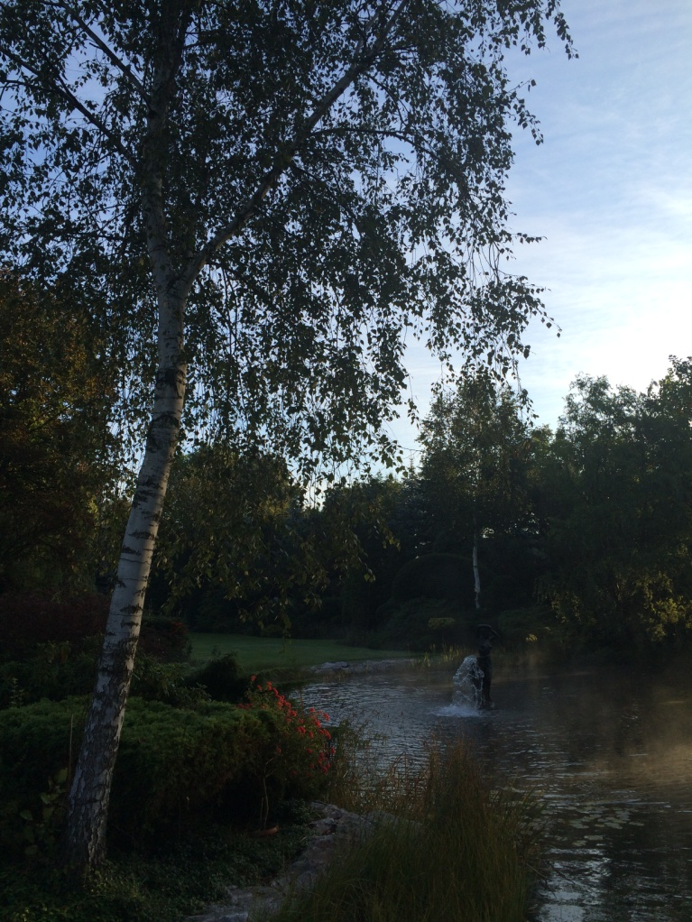
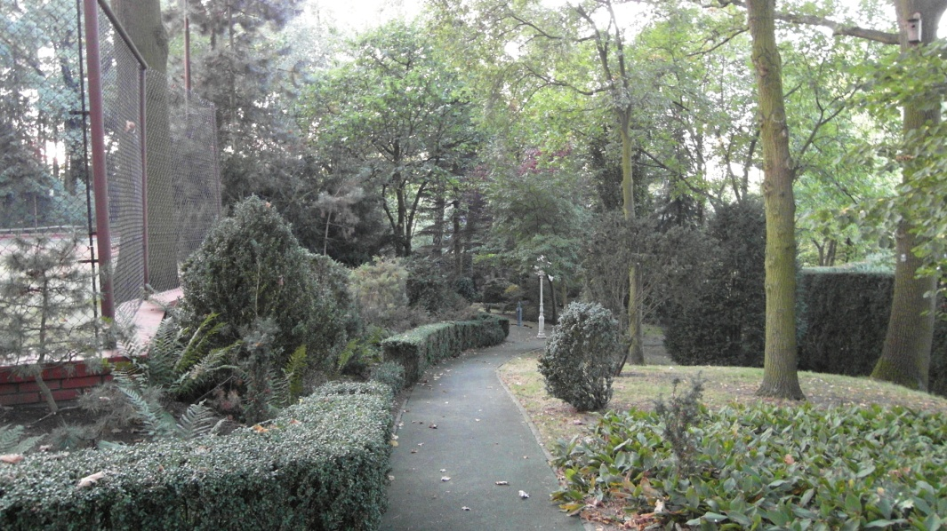
The Satiricall scene
This picture was taken in my garden. For me this is a satiricall ,because it have a lot of nature in it.

Slide 5
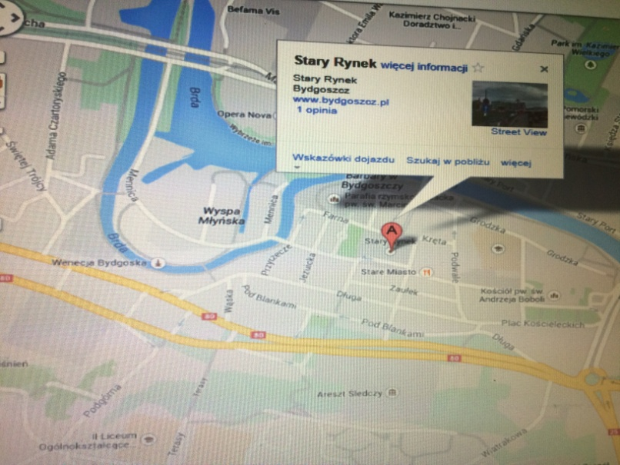
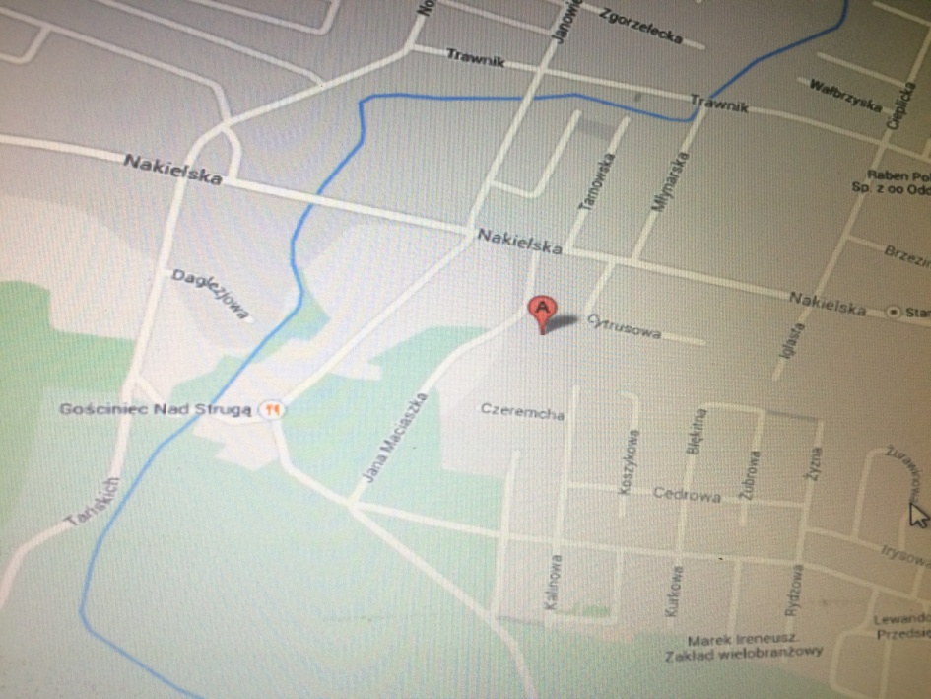
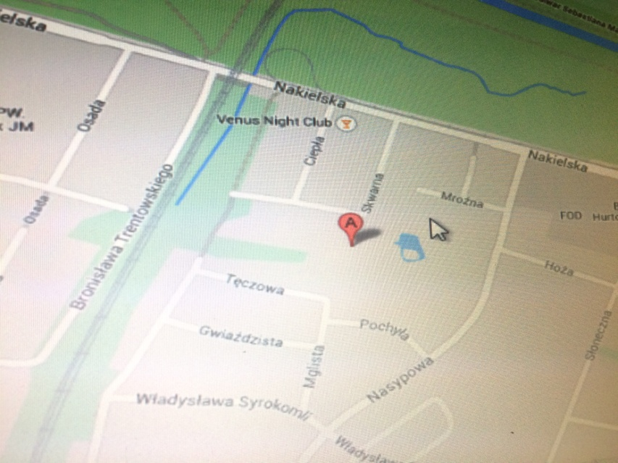
The places is which i took pictures

Slide 6


