Slide 1
Bydgoszcz in the eye of Sebastian Serlio
By Bénédicte Langrand
G8

Slide 2
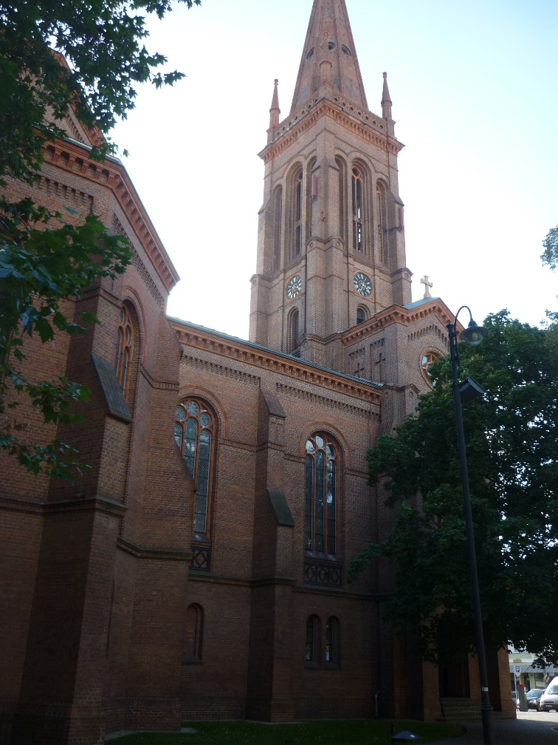
The Comic Scene:
This particular scene can include houses, a church,
and some buildings.
I chose to make a picture of this
church because it is in my neibourhood and can
describe a comic scene.
This church is situated on pl. Wolnosci.
St Peter’s Church
Taken on the 27/09/2014

Slide 3
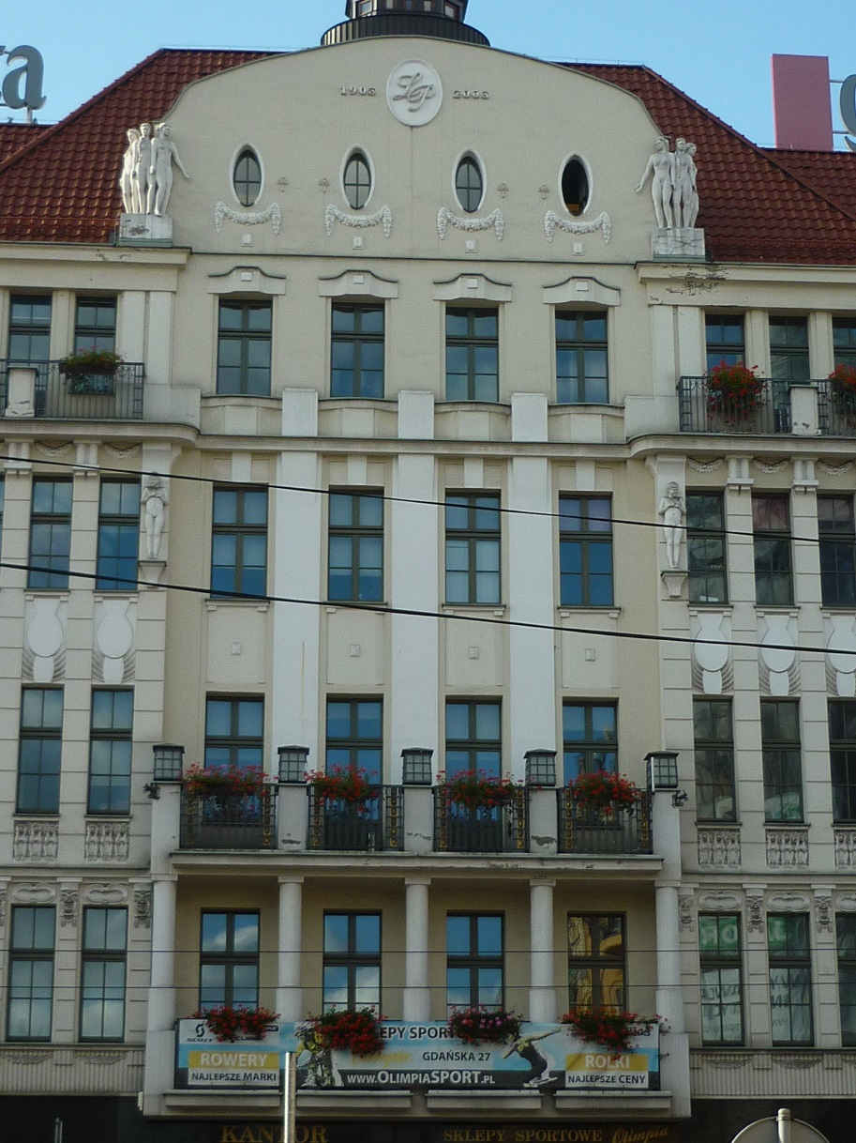
The Tragic Scene:
This type of scene may include houses made for
great people,chimneys
and towers. Serlio chose this kind of background
because strange adventures
and cruel murders can be performed there.
This building is also near pl. Wolnosci.
I chose to make this picture because I thought
A beautiful building is better than chilneys and
that, in my opinion, it describes the scene better.
Near pl. Wolnosci
Taken on the 27/09/2014

Slide 4
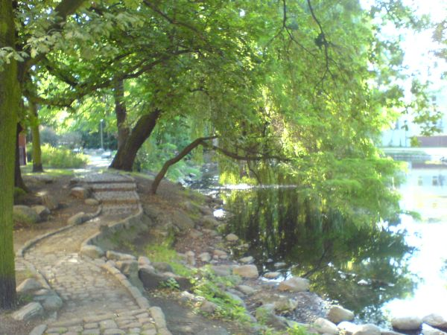
The Satirical Scene:
This scene is supposed to include trees, roots, grass,hills, flowers and country houses.
For me, this picture is the one that describes any of the scenes best because there are almost everything I mentioned except hills and country houses.
This place is bordering pl. Wolnosci.
Parc Kasimir the Great
Taken on the 27/09/2014

Slide 5
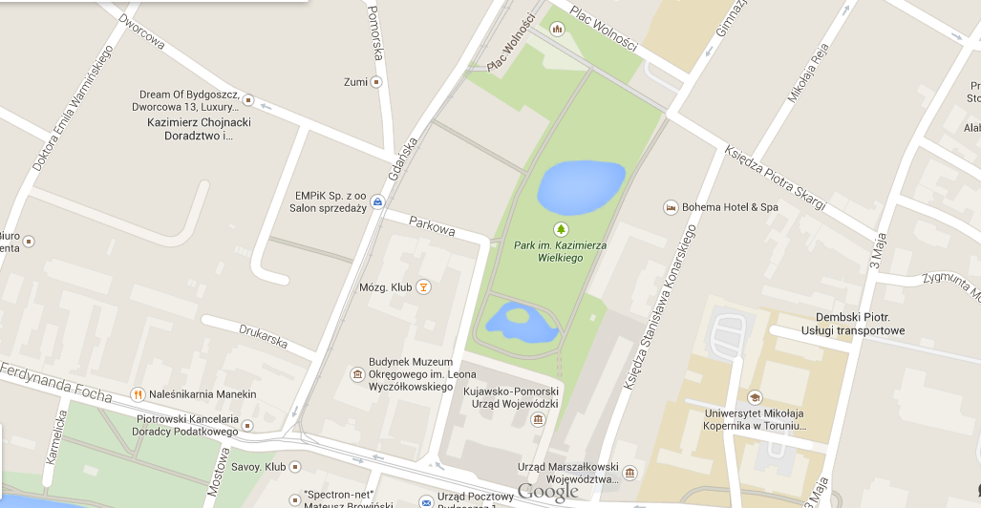
Comic
scene
Tragic
scene
Satiridal
scene

