Slide 1
Bydgoszcz in the Eyes of Sebastian Serlio
Ania Wnuk G8

Slide 2
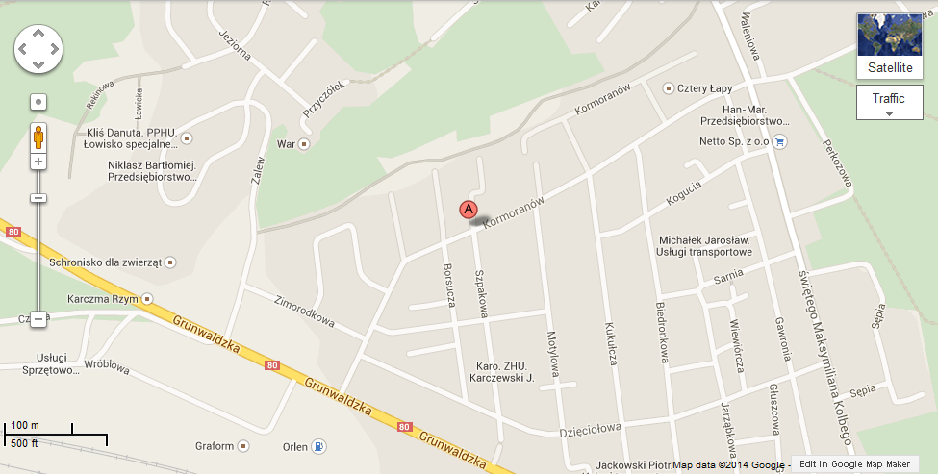
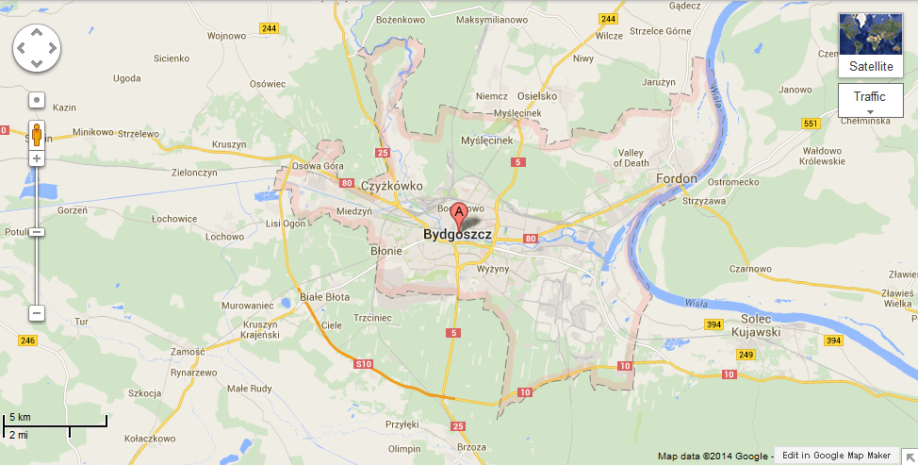
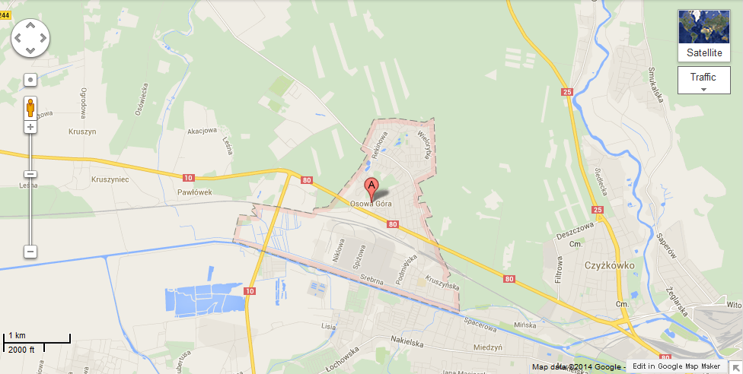
Bydgoszcz, Osowa Góra, ul. Kormoranów, „SIM"
All of the pictures were taken at the same place and day (05.10.2014).

Slide 3
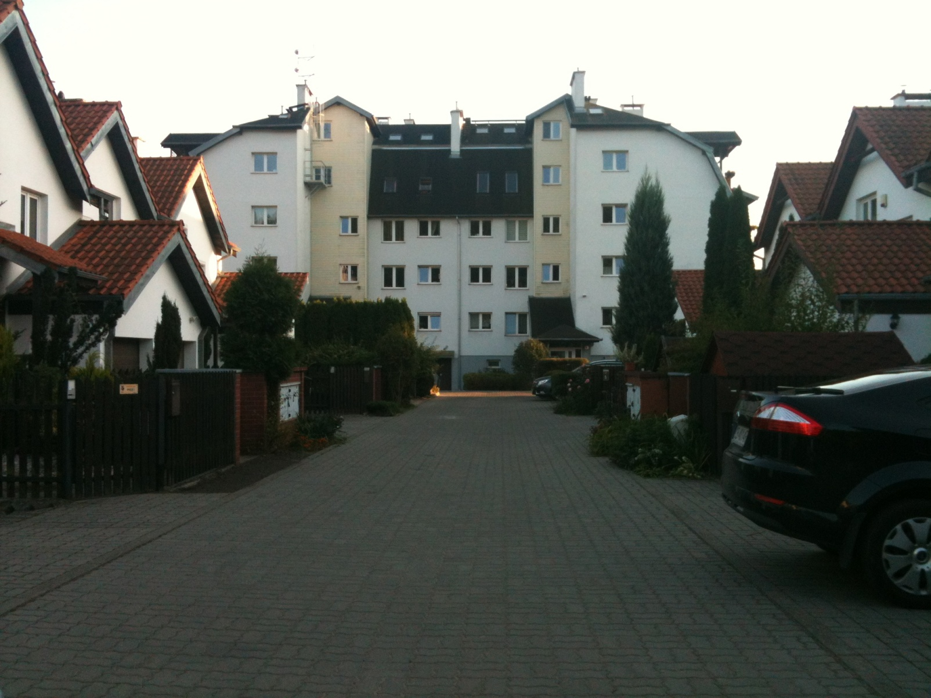
The Comic Scene

Slide 4
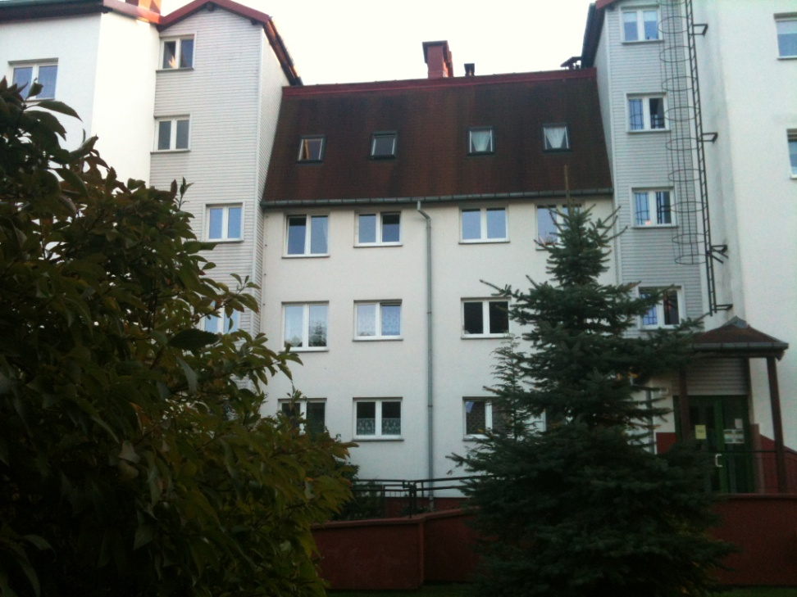
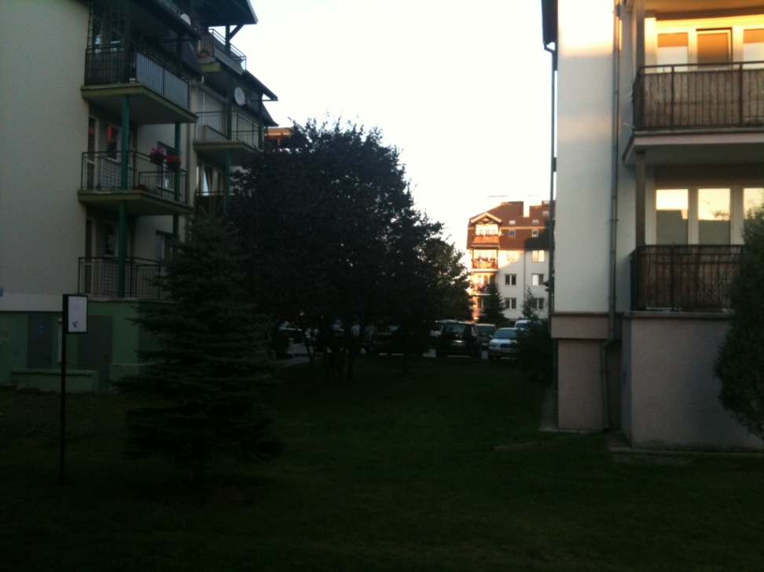
The Tragic Scene
I made two pictures and wasn’t sure which to pic, so I put both as examples.
This one
Or this one

Slide 5

The Satiricall Scene
I’ve made a video because camera couldn’t catch all in one picture (click it to play it).

